Slide 1
Traditional Decision-making and Rights over Natural Resources in West Africa
Prof. Dr. Brigitte Fahrenhorst
TU Berlin / SID Berlin

Slide 2
Background
PhD research - trad. decison-making & customary law in Burkina Faso: 7 years research, ltd. literat., research on local ground, all over West Africa
Research on behalf BMZ*: trad. land rights in global south
Research/development of socio-ecological impact assessment**
Impact evaluation of all Austrian projects, ca. 10 years
Univ. research on land rights of pastoralists (with 5 Afric. Univ.)***
Interdisc. univ. research on women‘s rights, agrarian research & consultancy methods
*German Fed. Min. of Economic Dev. & Coop.
**on behalf Austrian Fed. Min. of Foreign Affairs).
*** on behalf German Fed. Min. Educat. & Research and African Union /EU

Slide 3
Contents
Overview West Africa
Character of customary land and tree right (tenure rights)
Character of traditional decision-making
Examples of ethnical groups and their decision-making and their customary law
Momentous blindness – desastruous impact

Slide 4
1. Overview - West Africa
https://www.courses.psu.edu/test/test100_hkr/AFIM/Main_HTML/RG_W.html

Slide 5
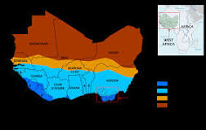
Overview
Country* | Year | Literacy rate in %
Benin | 2012 | 33
Burkina Faso | 2014 | 35
Chad | 2016 | 22
Cote d'Ivoire | 2014 | 44
Ghana | 2010 | 71
Mali | 2015 | 33
Mauritania | 2007 | 46
Niger | 2012 | 31
Nigeria | 2008 | 51
Senegal | 2017 | 52
Togo | 2015 | 64
population ca. 367 mio. (2015, UN)
Life expectancy: M 59, F 62 years (2018) **
Climate***
* https://data.worldbank.org/indicator/SE.ADT.LITR.ZS?end=2010&locations=ZG-1W-Z4-8S-Z7-ZJ-CI&start=2010&view
** https://www.statista.com/statistics/274511/life-expectancy-in-africa/
*** https://www.google.de/search?q=climate+west+africa+map&tbm=isch&source=iu&ictx=1&fir=BQEIEFfkJ0F8tM%253A%252Cj-MURVd6Lk3jkM%252C_&vet=1&usg=AI4_-kTuSPfn49tP5YaaXwdgNSIwkBt2Yw&sa=X&ved=2ahUKEwj1rbSn-o7iAhVFbVAKHcWQA1AQ9QEwC3oECAkQBA&cshid=1557422593241218#imgrc=BQEIEFfkJ0F8tM:

Slide 6
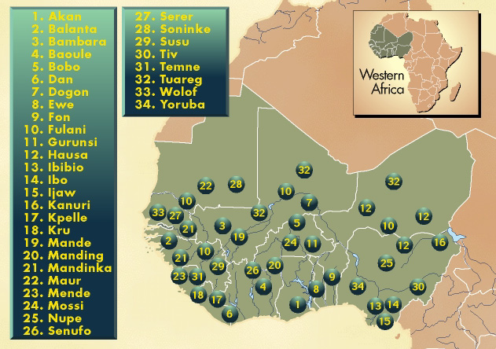
Ethnic Groups
https://www.courses.psu.edu/test/test100_hkr/AFIM/Main_HTML/EG_W.html

Slide 7
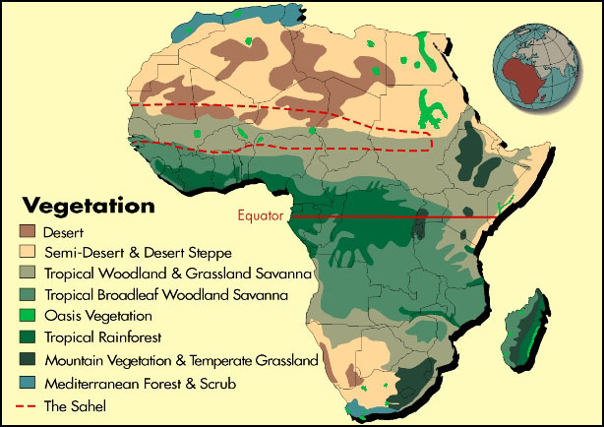
Vegetation
https://www.courses.psu.edu/test/test100_hkr/AFIM/Main_HTML/M_NV.html

Slide 8
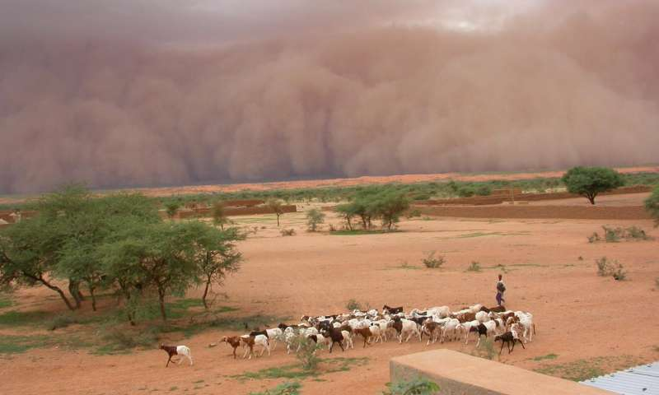
https://www.google.de/search?q=sahel+West+Africa+fotos&tbm=isch&source=iu&ictx=1&fir=AJCUBLtvbk5AtM%253A%252C2tqOaJdQNJj2eM%252C_&vet=1&usg=AI4_-kToEN93LzvkotLDv7MdGWR0uzIo1w&sa=X&ved=2ahUKEwid6Z2yxpDiAhVMUlAKHQ2RDBoQ9QEwA3oECAkQCg#imgrc=16lq3Tnk1x1SjM:&vet=1

Slide 9
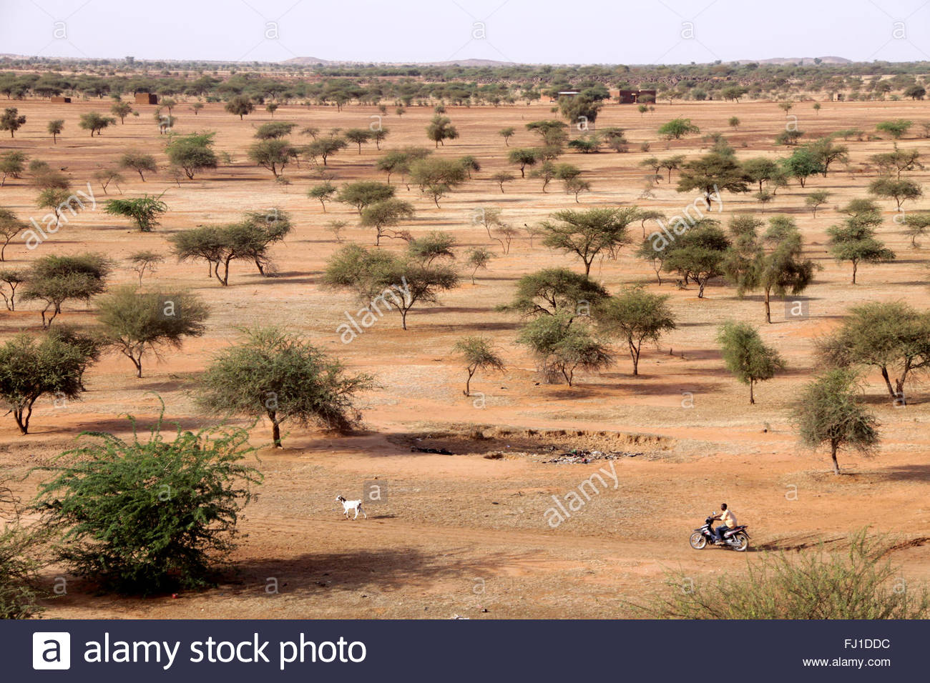
https://www.google.de/search?q=sahel+West+Africa+fotos&tbm=isch&source=iu&ictx=1&fir=AJCUBLtvbk5AtM%253A%252C2tqOaJdQNJj2eM%252C_&vet=1&usg=AI4_-kToEN93LzvkotLDv7MdGWR0uzIo1w&sa=X&ved=2ahUKEwid6Z2yxpDiAhVMUlAKHQ2RDBoQ9QEwA3oECAkQCg#imgrc=AJCUBLtvbk5AtM:&vet=1

Slide 10
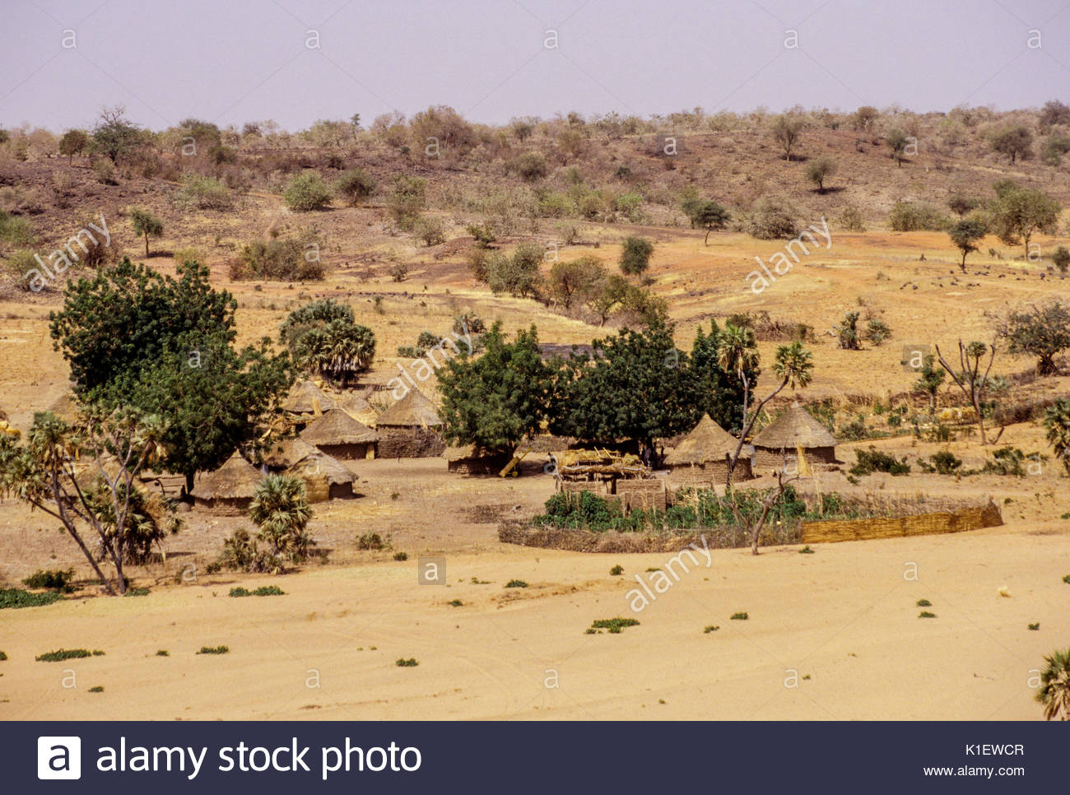
https://www.google.de/search?q=sahel+West+Africa+fotos&tbm=isch&source=iu&ictx=1&fir=AJCUBLtvbk5AtM%253A%252C2tqOaJdQNJj2eM%252C_&vet=1&usg=AI4_-kToEN93LzvkotLDv7MdGWR0uzIo1w&sa=X&ved=2ahUKEwid6Z2yxpDiAhVMUlAKHQ2RDBoQ9QEwA3oECAkQCg#imgrc=3RwkkUIPP5qFGM:&vet=1

Slide 11
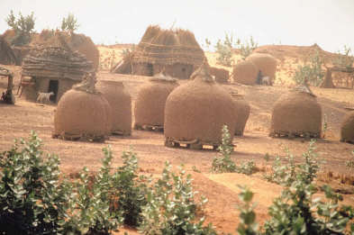
https://www.google.de/search?q=lehmh%C3%BCtte+afrika&tbm=isch&source=univ&sa=X&ved=2ahUKEwilnsWu8pDiAhXQwcQBHQTrCEkQ7Al6BAgIEA0&biw=1280&bih=531#imgrc=mOGU0Kq0L3mI_M:

Slide 12
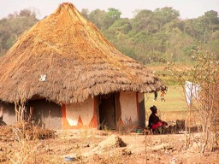
https://www.google.de/search?q=lehmh%C3%BCtte+afrika&tbm=isch&source=univ&sa=X&ved=2ahUKEwilnsWu8pDiAhXQwcQBHQTrCEkQ7Al6BAgIEA0&biw=1280&bih=531#imgrc=ggpX7OZvVIZmDM:

Slide 13
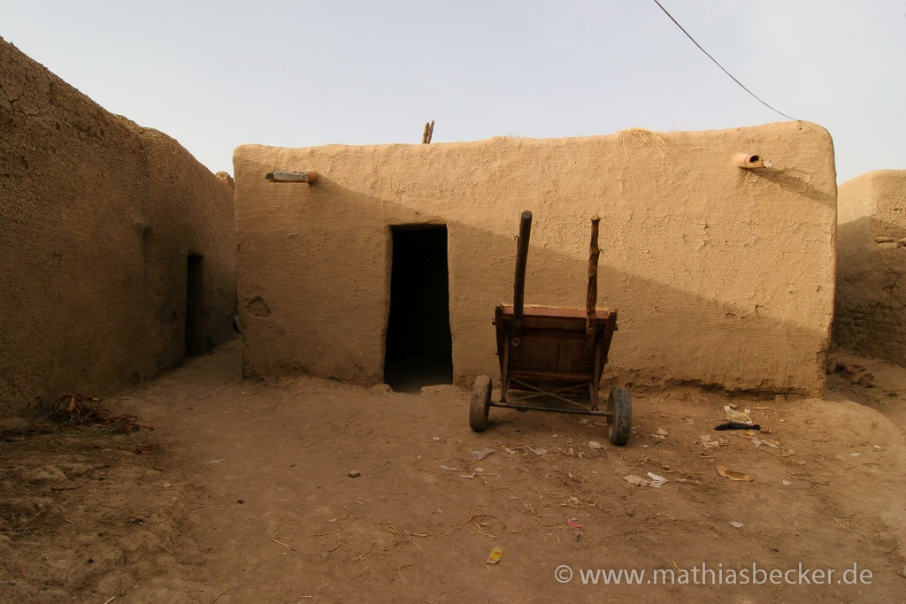
https://www.google.de/search?q=lehmh%C3%BCtte+afrika&tbm=isch&source=univ&sa=X&ved=2ahUKEwilnsWu8pDiAhXQwcQBHQTrCEkQ7Al6BAgIEA0&biw=1280&bih=531#imgrc=ICaPGWytWRubiM:

Slide 14
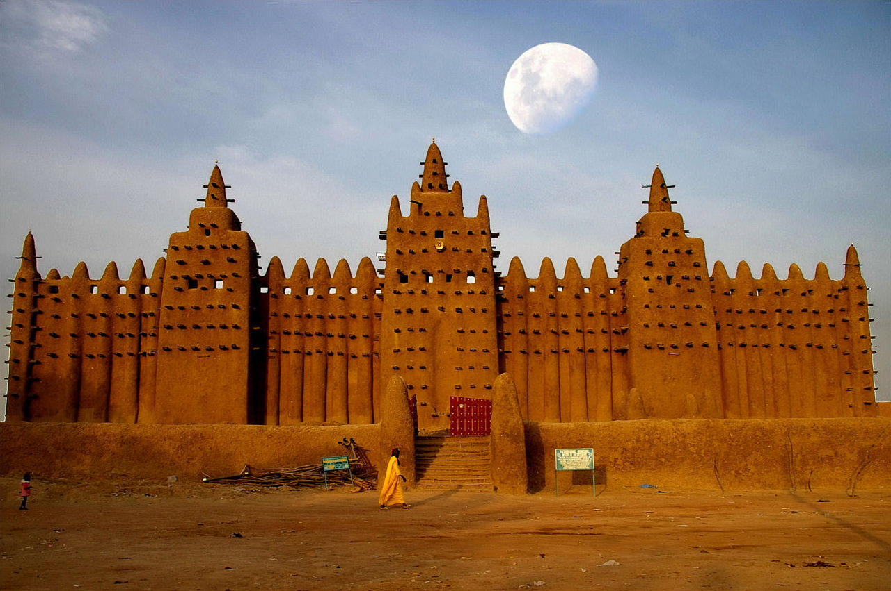
https://www.google.de/search?q=djenne+moschee&tbm=isch&source=iu&ictx=1&fir=9rcng0upPrWlKM%253A%252CMTH2f6V5mUP6dM%252C_&vet=1&usg=AI4_-kS9zuhTFLvJGpfrfCH3AfeikUCZQg&sa=X&ved=2ahUKEwix39CrypbiAhUQxqYKHbjcBD4Q9QEwAnoECAkQBg#imgrc=egkbLBPleWMKoM:&vet=1

Slide 15
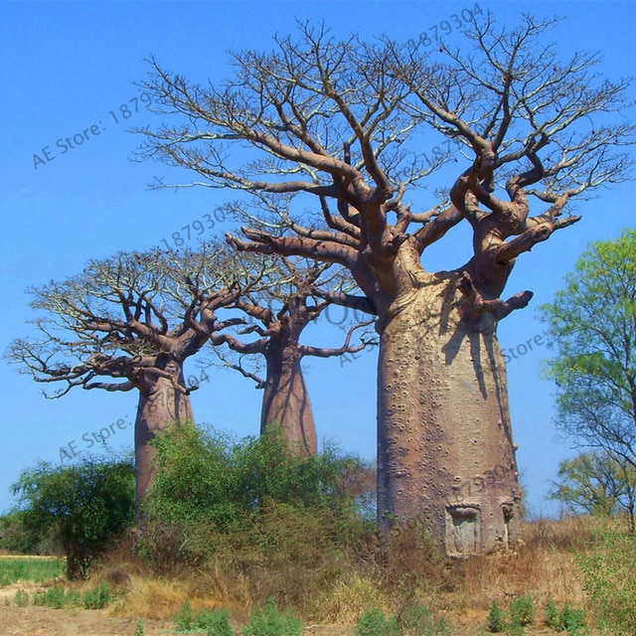
https://www.google.de/search?q=baobab+baum&tbm=isch&source=iu&ictx=1&fir=zXnhnuMCnj5Q2M%253A%252CXnz9Hlj7gIV6HM%252C%252Fm%252F02qc_h&vet=1&usg=AI4_-kRDecpaj_KbqBJ1XbTI022S66ZA5A&sa=X&ved=2ahUKEwiuvsK4-pDiAhXsw8QBHeLZCTgQ_B0wFXoECAwQBg#imgrc=FtgdBtj8p-B1wM:&vet=1

Slide 16
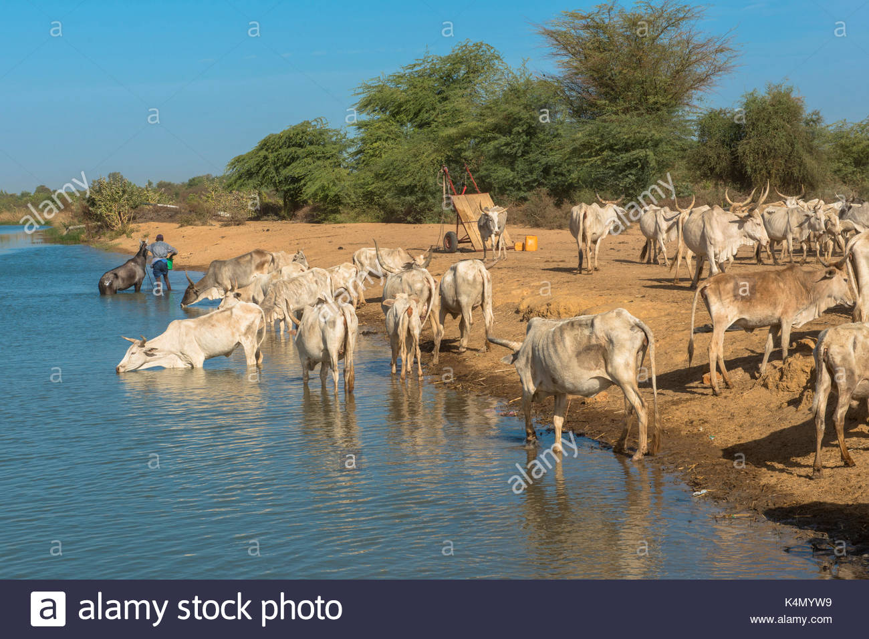
https://www.google.de/search?q=zebu+westafrika&tbm=isch&source=iu&ictx=1&fir=1C1Q3tJq9t2hRM%253A%252CB7ayCj3RiiIDTM%252C_&vet=1&usg=AI4_-kRKuQUWAqfK90UB8XbjuSLM3fKk-A&sa=X&ved=2ahUKEwjptLPp-5DiAhXF4aYKHVg7APQQ9QEwCXoECAkQCA#imgrc=BsvYBgH3vttg4M:&vet=1

Slide 17
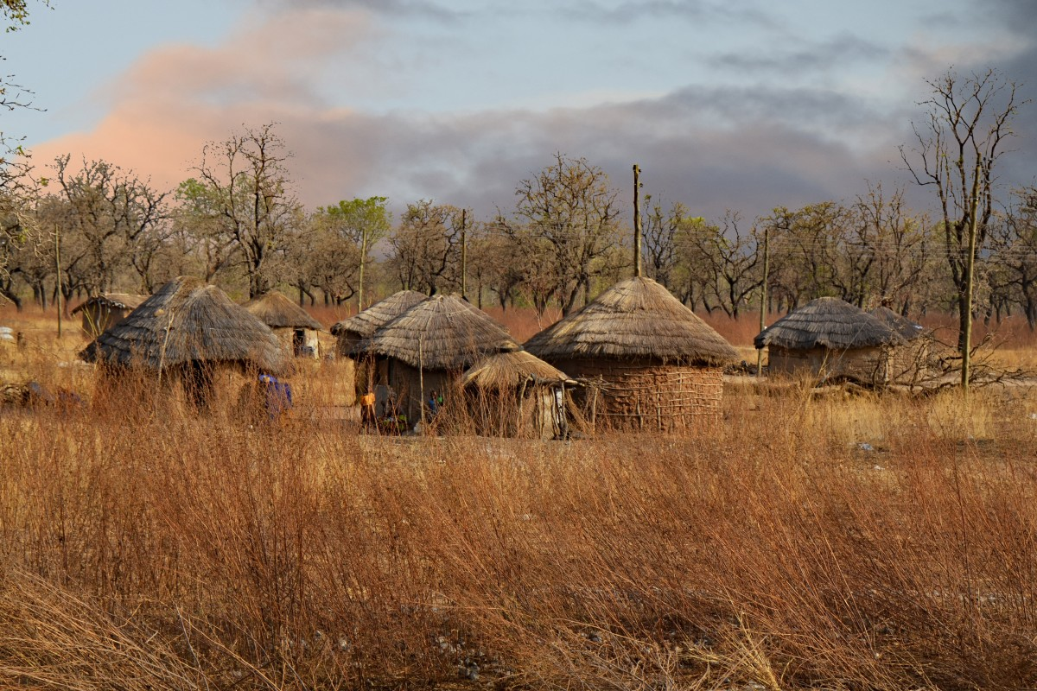
https://pxhere.com/de/photo/1206987

Slide 18
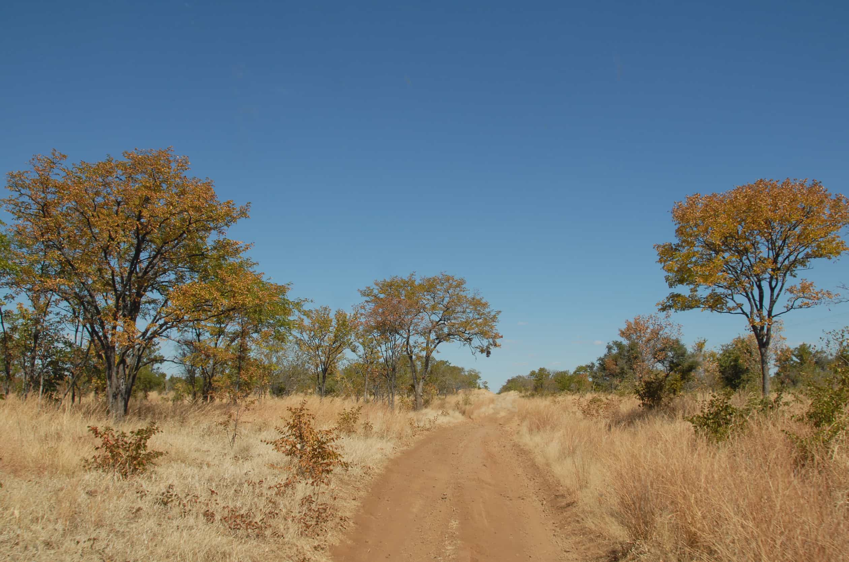
https://www.google.de/search?q=lehmh%C3%BCtte+afrika&tbm=isch&source=univ&sa=X&ved=2ahUKEwilnsWu8pDiAhXQwcQBHQTrCEkQ7Al6BAgIEA0&biw=1280&bih=531#imgrc=QR6Vblm7vYsxQM:

Slide 19
2. Character of customary land and tree law/ rights - tenure rights)
Characterized by
Flexibility
Solidarity
Adapted to nature / nature protection
Equity
Risk minimizing

Slide 20
Principles:
Territory defined as ethnical land, sometimes several ethnic groups
Inside the territory: Individual property and common property
Investment of labour creates property (family property)
Private land – size according to needs and labour force
Planting of trees creates property (family property)
Common property: use rights for all group members
Most societies patrilinear = women only get use rights (unmarried men as well)
Land cannot be sold – the ancestors live in the ground
Land can be lent to impoverished group members (restrictions)

Slide 21
Holy Forest |  |  | Territory
 | Common | Common | Common |  | Private property
 | Common | Property | Common
 | Common | Common | Common |  |  | Private property
Private property |  |  | Private property |  | Private property

Slide 22
Traditional land use – risk minimizing
Bush field X |  | Bush field Y |  | Bush field A
 | House field Y |  | House field A
 |  |  |  | House field X
Bush field B
 |  | House / Court B |  | House field B
 |  | House garden B
 | House/ Court Y |  | House/Court X
 | House garden Y |  | House garden X
 |  | House/ Court A
Bush field Y |  | House garden A |  | House field B
 | House field A |  | House field Y
Bush field X |  | House field X
 | Bush field B |  |  | Bush field A

Slide 23
3. Character of traditional decision-making
Characterized by
Consensus
Justice
Transparency
Equity
Power control
Fair and just distribution

Slide 24
4. Examples of ethnical groups and their decision-making
Lobi
Bobo
Mossi

Slide 25
Lobi - Settlement – extended family
Oldest man |  |  | dead | Cousin of the wife
head |  |  |  | Takes over power for a phase
decides everything |  |  |  | everything allowed
accumulates goods & power |  |  |  | power & goods distributed
Family | Family | Family

Slide 26
Bobo village (different ethnical groups)
Village head Elects | Guardian of just distribution | Guardian of just distribution |  |  |  |  | Master of the earth (spirital head)
Council of elders
Family head | Guardian just distribution |  |  | Family head | Guardian just distribution
Family |  |  |  | Family

Slide 27
Mossi Kingdom
King – Moro Naaba – highesT naam |  |  |  | Ministers - no naam
Selected by King‘s family
village head – naam No access to land |  | village head – naam No access to land |  | Master of the earth - no naam, but Spiritual Position
Family head, no naam |  | Family head, no naam
Family, no naam |  | Family, no naam
Only Lost-naam people/ warriors, or no-naam people (Slaves, other ethnic groups) = outsiders can become ministers

Slide 28
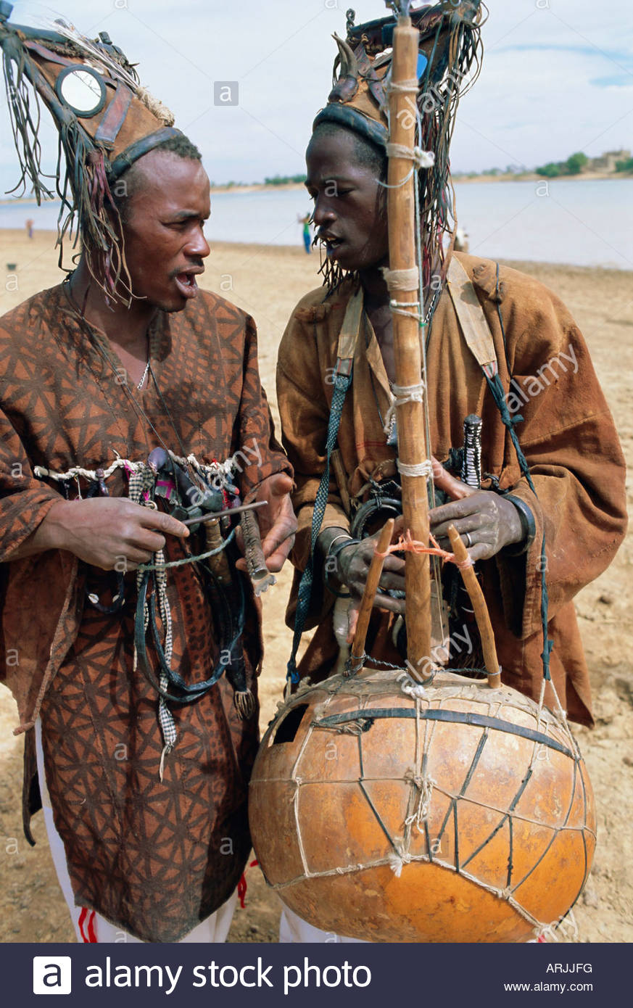
Griots
Journalist – news Mediator https://www.alamy.de/fotos-bilder/griots.html https://www.google.de/search?q=traditioneller+griot+westafrika+foto&tbm=isch&source=iu&ictx=1&fir=eKICAUjXeKhL3M%253A%252ChzQaoBtlX07YvM%252C_&vet=1&usg=AI4_-kTRvGT939k3OUl914AFiwU2iQtP6Q&sa=X&ved=2ahUKEwj3gPGA3JPiAhXRJVAKHW4XC6kQ9QEwA3oECAkQCg#imgrc=eKICAUjXeKhL3M:

Slide 29
5. Momentous blindness – desastruous impact
Example French colonizers – land registration „Tragedy of the commons“ (Hardin) Example land consolidation in oasis (GTZ) Land for sale Introduction of tax - Introduction of goats Forced migration to plantations Forced move to French military Destroying holy forests Forced cotton production Power to village heads – weakening power control institutions | Changing social structures | Desertification Erosion Hunger Poverty Forest destruction Corruption Inequality

Slide 30
Thanks for your interest

