Slide 1
Women's Land Rights under threat:
Solutions from a global network

Slide 2
Outline
ILC – a diverse global network with one goal
Why Land Rights – and why women's land rights?
Current trends and opportunities
Good practices from the ILC network
Recommendations

Slide 3
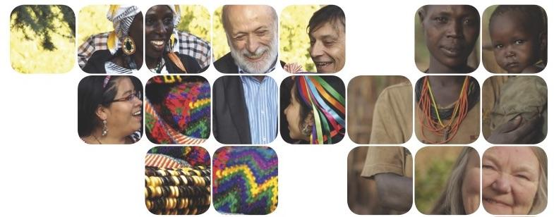
United for Land Rights
70+ countries
262+ members
25+ national platforms
4 regional platforms
A coalition of equals
One goal: people-centred land governance

Slide 4
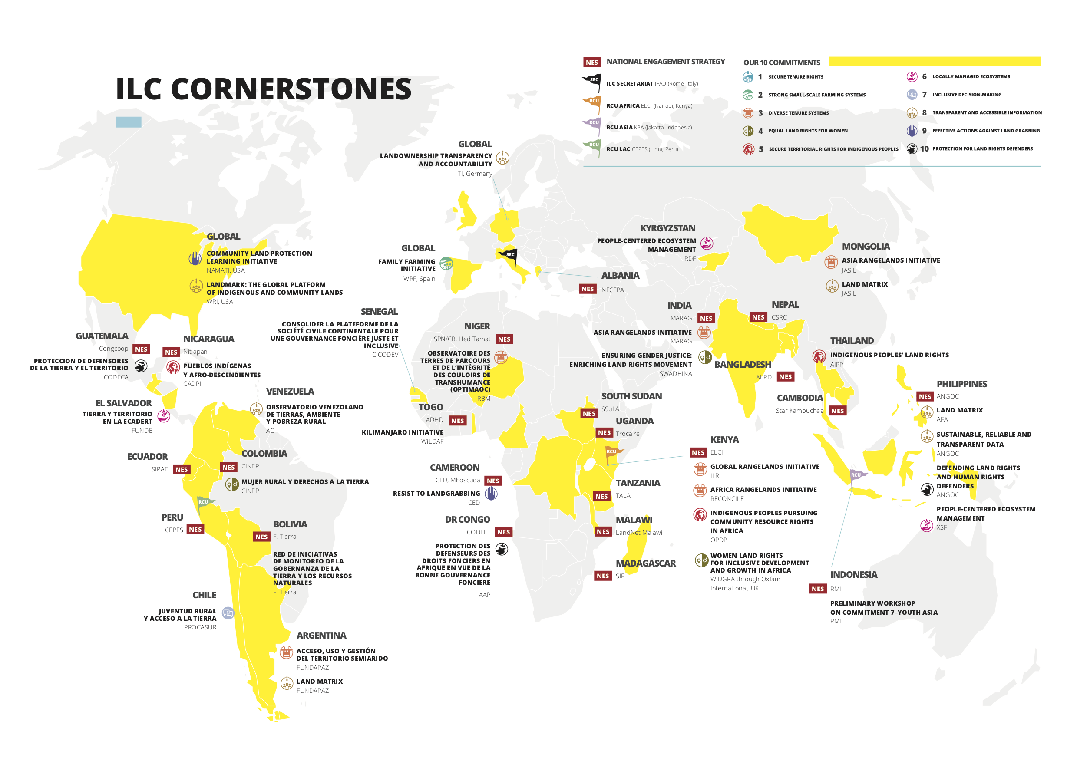
Notes:
overview of member initiatives in the ILC network

Slide 5
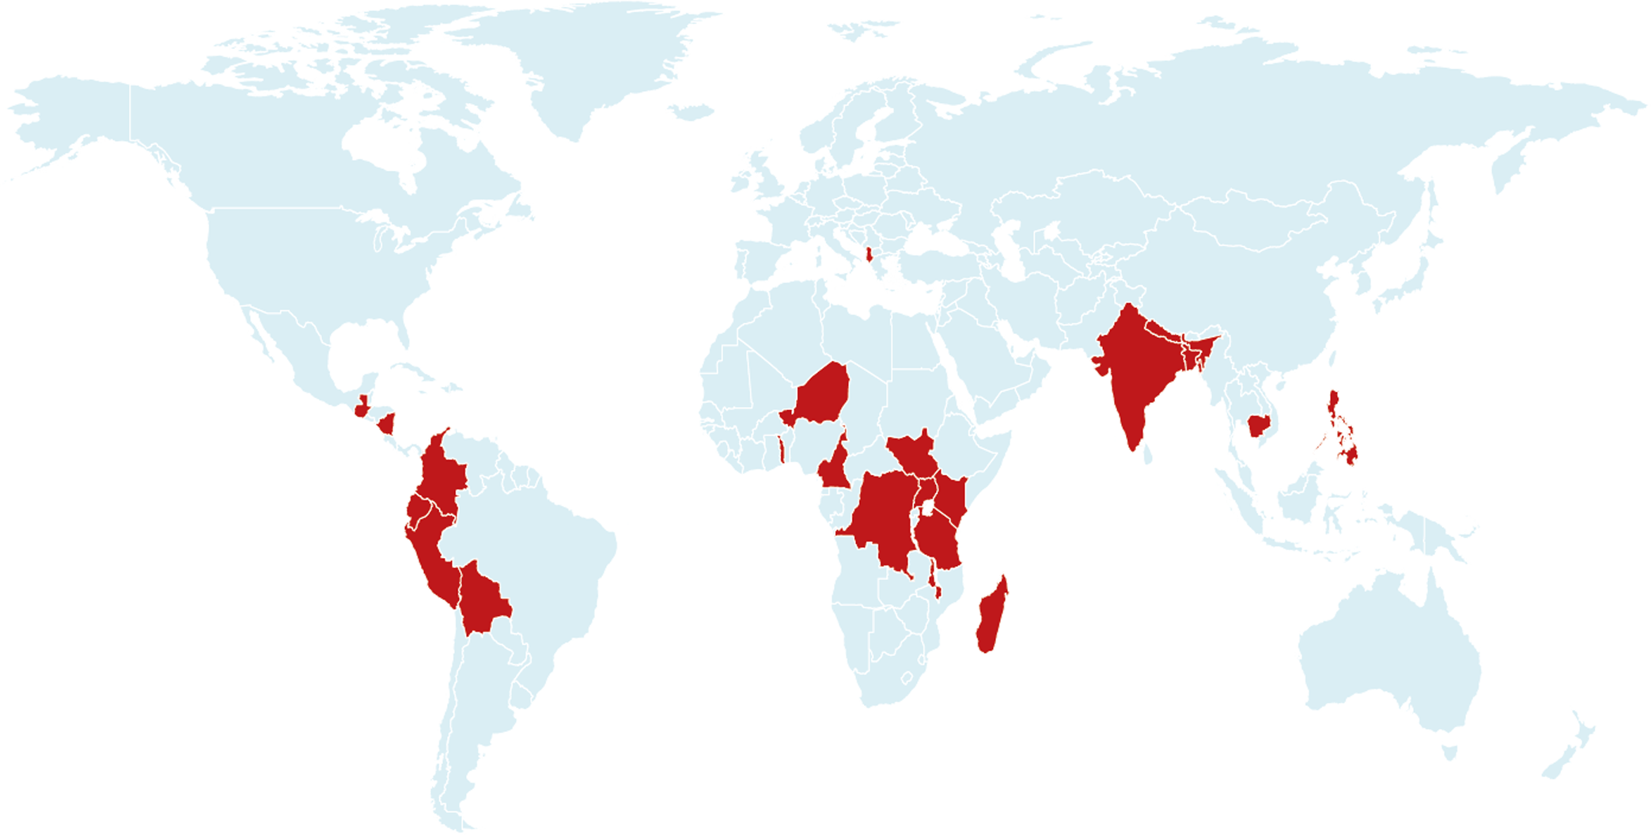



NATIONAL ENGAGEMENT STRATEGIES
300+ organisations working together in 20+ countries!
ALBANIA
KOSOVO (tbc)
MOLDOVA
CAMEROON
DR CONGO
GHANA (tbc)
KENYA
MADAGASCAR
MALAWI
NIGER
SENEGAL
SOUTH AFRICA
SOUTH SUDAN
TOGO
TANZANIA
UGANDA
ARGENTINA
BOLIVIA
COLOMBIA
ECUADOR
GUATEMALA
NICARAGUA
PERU
BANGLADESH
CAMBODIA
INDIA
INDONESIA
KYRGYZSTAN
MONGOLIA (tbc)
NEPAL
PHILIPPINES

Slide 6
People-centred land governance
Our Commitments
1. Secure tenure rights
2. Strong small-scale farming systems
3. Diverse tenure systems
4. Equal land rights for women
5. Secure territorial rights for Indigenous Peoples
6. Locally-managed ecosystems
7. Inclusive decision-making
8. Transparent and accessible information
9. Effective actions against land grabbing
10. Protected land rights defenders

Slide 7
Why Land Rights?
= Human Rights & sustainable development
Small farms provide livelihoods for 2.5 billion people & up to 80 per cent of food produced (Asia & sub-Saharan Africa)
1 billion people in rural areas lack secure rights to land
Define opportunity, income, housing, economic and nutritional security, political power, and social status within communities
fundamental to address major challenges facing humanity

Slide 8
Context
Trends and opportunities
Increasing attention
Recognition of land rights as central to livelihoods
Women’s land rights & broader women’s rights agenda
Sustainable Development Goals (SDGs)
Concentration of ownership
Food price crisis & land grabbing
Threats to land rights defenders:
https://www.facebook.com/GlobalWitness/videos/10156505627736323/?t=96

Slide 9
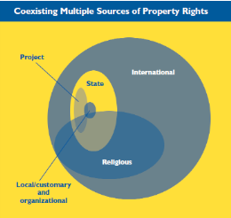
Definitions:
Land Governance
Land Tenure
Land rights
Property rights
Legal Pluralism

Slide 10
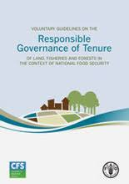
Voluntary Guidelines
Responsible governance of tenure of Land
2012 watershed moment
International consensus
Reference/benchmark for states, civil society, private sector
Gender equality principle (influence, treatment, outcome)

Slide 11
Women’s Land rights
Gender equality in land governance
De jure and de facto equality
Decision-making/control
Challenges:
    Laws and policies that are not adequate
    Legal loopholes, lack of implementation/enforcement
  Women claim land rights through relatives
  https://www.youtube.com/watch?v=cC2ZO10EvcA

Slide 12
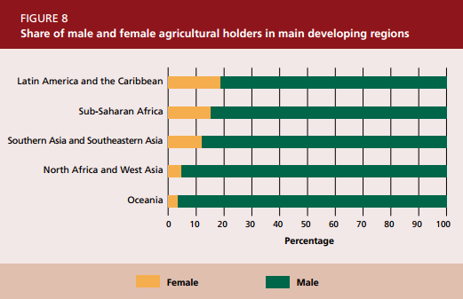

Slide 13
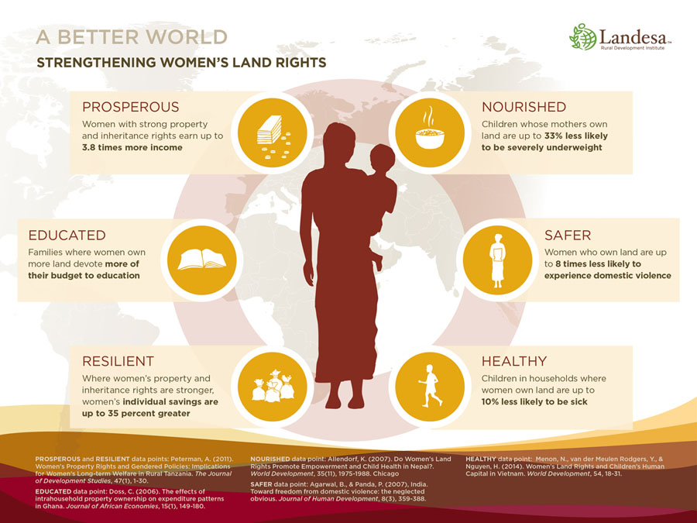

Slide 14
Lessons from ILC members
Processes, tools, methods used
Legal assistance, legal empowerment, access to justice
Use of media and communication
Knowledge &Info Management, Mapping, Land Registration
Land Policy & Multi-Stakeholder Dialogue
Land Monitoring, Indicators, Alternative Reporting

Slide 15
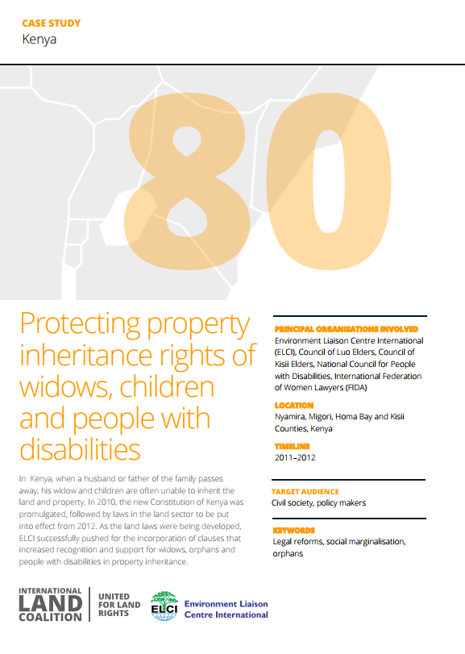
Use of media & comms
Environmental Liaison Centre International, Kenya
Radio broadcasts to communicate with traditional leaders:
Took opportunity in post-Constitution period to influence laws under formulation
Worked to raise awareness & capacity of elders to apply new legal provisions in conflict resolution
Used respected elder as facilitator/expert for radio talks & phone-in in vernacular
Involving elders as champions raised legitimacy of women’s land rights in communities

Slide 16
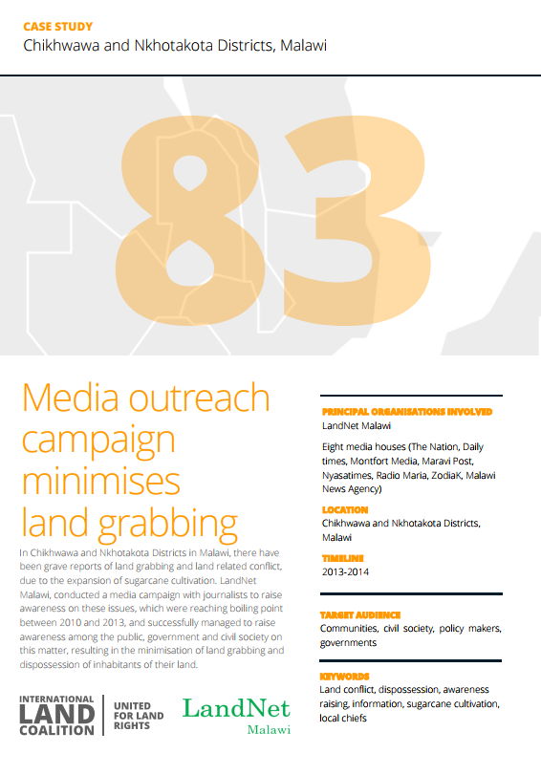
Use of media & comms
LandNet Malawi
Media campaign to raise awareness on land grabbing due to large-scale commercial farming affecting most vulnerable, often women, farmers:
Involved journalists from 8 media houses visiting field sites to listen to villagers
Stories exposed role of government, private investors, local elites and village chiefs
Provided platform for communities’ voices
General public targeted through through radio and print – led to public outcry & investigation
Contributed to passing of new laws and successful legal challenge

Slide 17
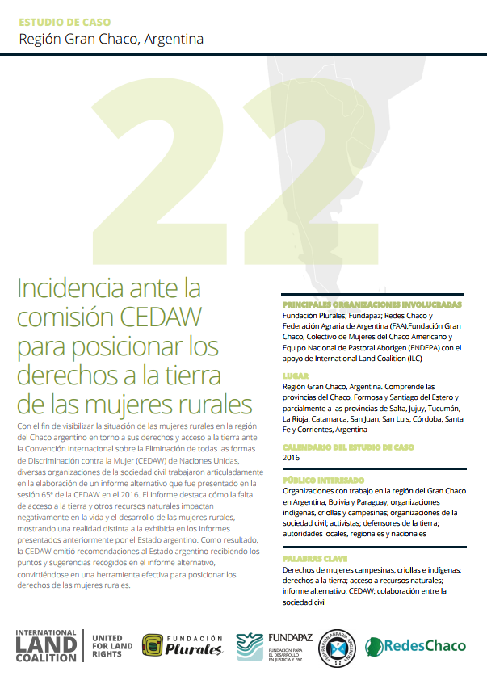
Alternative reporting
Fundación Plurales, Fundapaz, Redes Chaco, Federación Agraria de Argentina
Advocacy before CEDAW Committee for positioning rural women's land rights:
Collectively developed report that gives voice to women
Presented reality not covered in official reports of rural women lacking access to land & water and suffering pollution
Showed linkage between women’s rights and resource rights in the region
Built basis for continued monitoring, created awareness beyond borders & motivated activists to continue their struggle

Slide 18
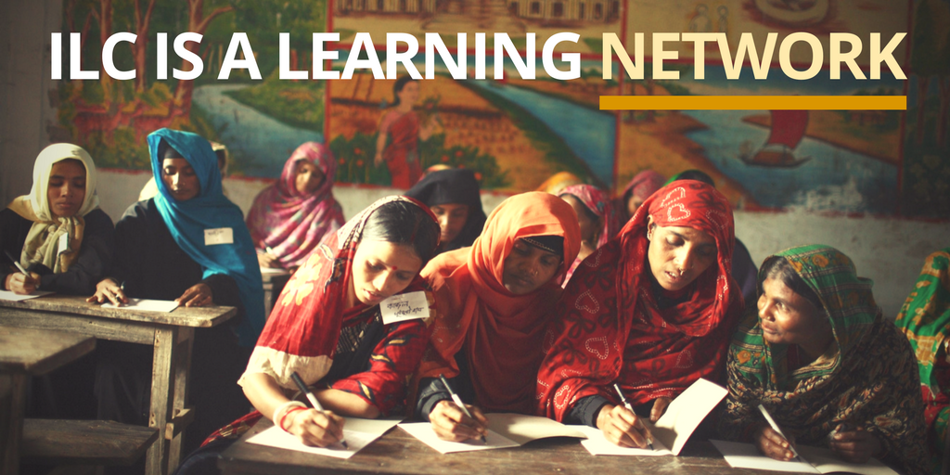
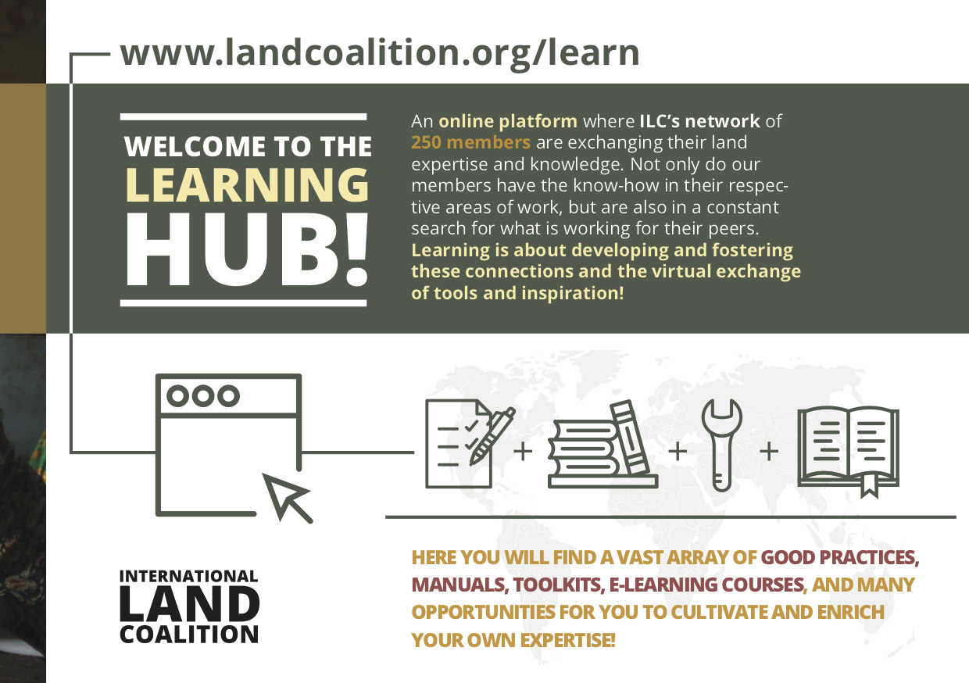
Notes:
Stress ILC’s focus on diverse members learning from each other

Slide 19
Conclusion/recommendations
Steps to strengthen women’s land rights
Eliminate discrimination under the law
Educating officials
Adjusting bureaucratic procedures
Titling/certification
(Legal) awareness/empowerment

Slide 20
"That women are equal to men and deserve equal rights, is no longer an earth-shattering idea, and that in itself is a great victory, but getting institutions and individuals to abide by it is another matter."
Rebecca Solnit

Slide 21
Thank you!
Visit www.landcoalition.org
or contact
s.pallas@landcoalition.org

Slide 22
Links for further info:
Landcoalition.org
Landportal.info
fao.org/gender-landrights-database/en/
www.thisisplace.org/

Slide 23
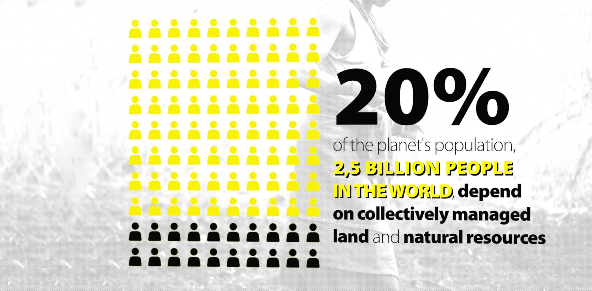
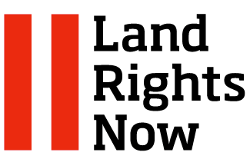
WWW.LANDRIGHTSNOW.ORG
Notes:
Land Rights Now is an international campaign to secure indigenous and community land rights. We mobilize and engage the public nationally and globally to exercise pressure on governments and raise awareness that secure collective land rights are at the heart of building a just and equitable world and are key to protect the planet and achieve sustainable development.
In 2017, the Land Rights Now campaign drew widespread attention to the urgency of securing community land rights (such as the global Earth Day mobilisation in April 2017, supporting 46 events across 29 countries) and provided targeted support to national campaigns (Peru, Liberia, Brazil, Nepal, Cameroon, South Africa). To date, more than 800 organisations (and thousands of individuals) have joined the Land Rights Now campaign, including more than 80 ILC members.

Slide 24
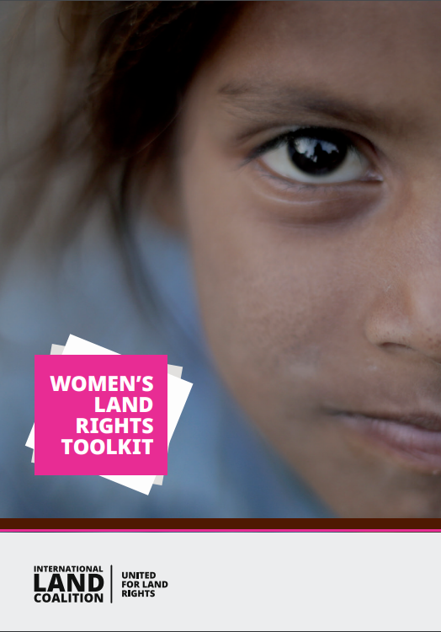
WLR toolkit
Tools successfully used by ILC members to promote, protect &strengthen women’s land rights:
Alternative reporting on Human Rights treaties
Using the Gender Evaluation Criteria
Earth festivals
Family land rights lineage trees
Groups of women claiming land rights

