Slide 1
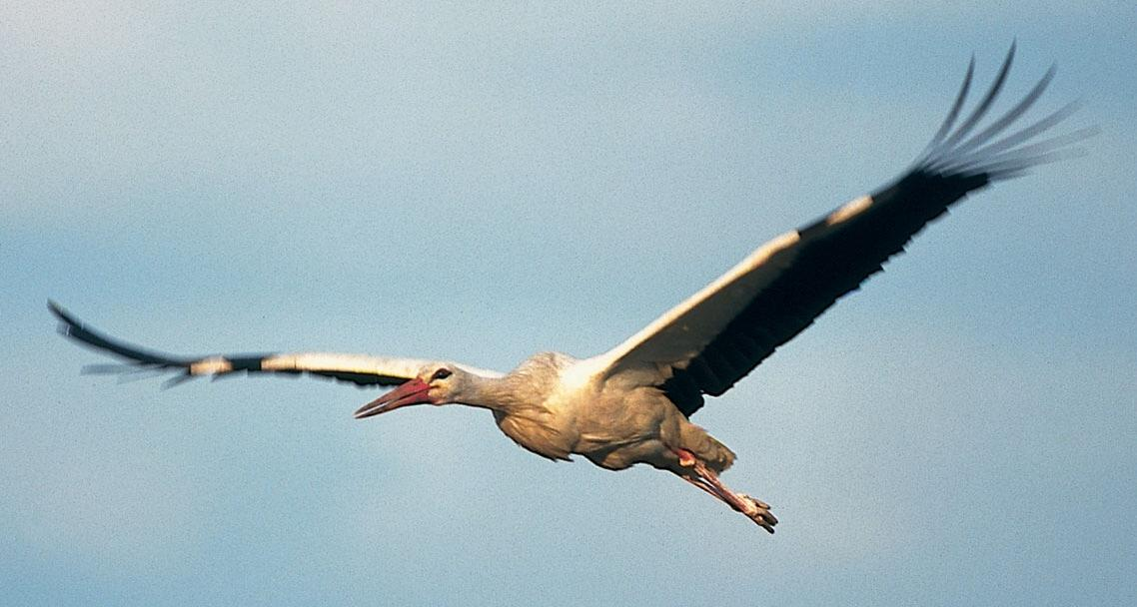


The EU‘s Agricultural Policy
Trees Robijns
12 June 2018

Slide 2
Overview of the presentation
Part I
  Agriculture in the EU
  Part II
  Zoom: agriculture & environment
  Part III
  The CAP of today
  Part IV
  A history of reforms
  Part V
  The 2013 Reform in more detail
  Part VI
  Where do we go next?

Slide 3
PART I: Agriculture in the EU
Notes:
Data source: Eurostat: https://ec.europa.eu/agriculture/statistics/facts-and-figures_nl

Slide 4
Agriculture in the EU
The Role of Agriculture
47 % of EU’s land area, 12 million farmers
7 % of all jobs (+ food sector) generating 6 % of GDP
    EU leading exporter of agricultural products
    Trends
1990-2010: number of farmers halved
Productivity increased significantly (intensification & specialisation)
Average farm size growing (15 ha), but still primarily on small family holdings

Slide 5
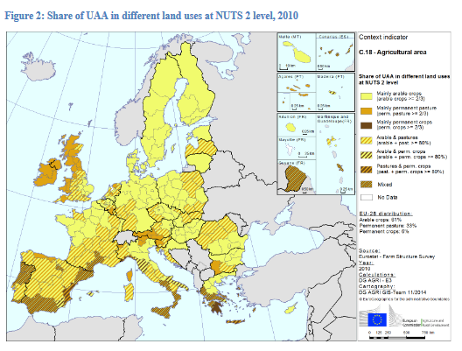
Notes:
THE LAND:
In the EU-28, the total utilised agricultural area (UAA) came to nearly 179 million ha in 2015.
•71 % of the total agricultural land is located in the EU -15 and 28% in the EU-N13.
•France has the largest agricultural area (29 million ha) covering 16% of the total UAA in Europe, followed by Spain (24 million ha), the
UK and Germany (both around 17 million ha).
•61% of the UAA was used for arable crops in 2013, 34% for permanent grassland and meadow, and 6% for permanent crops.
•More than 18.6 million hectares (10.7% of UAA) were potentially irrigable in 2013. 95% of this area is located in the EU-15, mostly in Southern Europe.
•The agricultural area irrigated at least once in 2013 in the EU-28 came to just over 10 million hectares, accounting for 5. 9% of the total UAA.

Slide 6
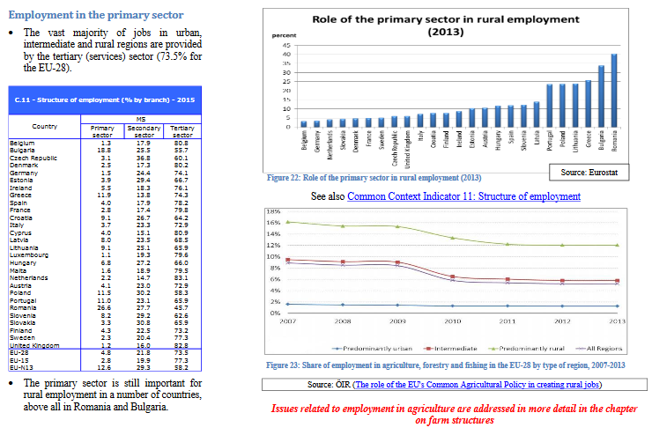
Notes:
2. THE JOBS / GDP (Value to the economy)

Slide 7
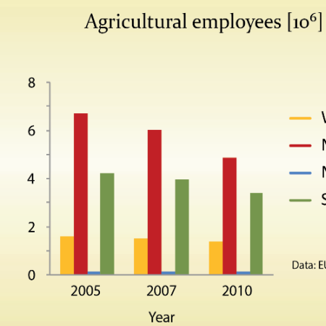
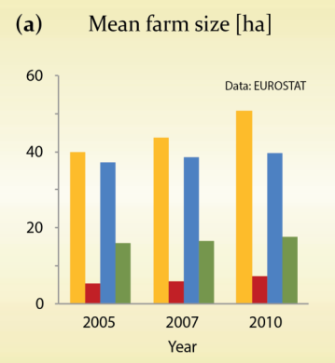
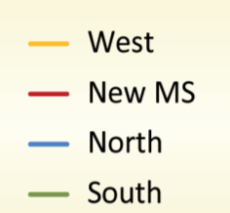
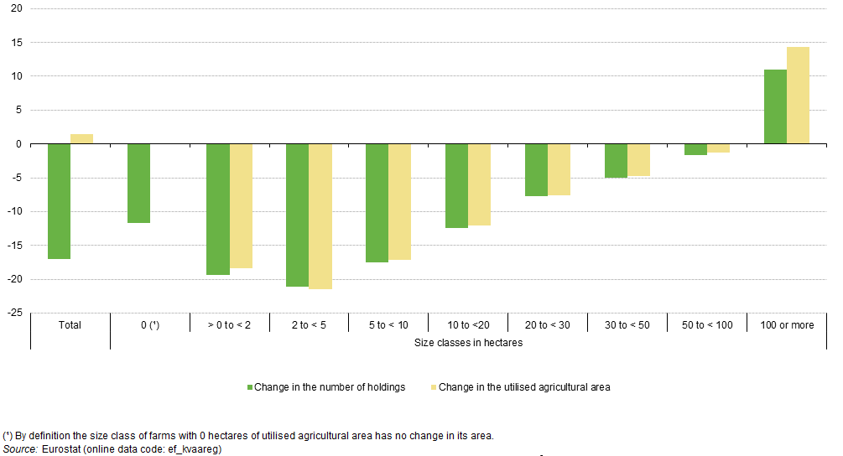
Trends: number of farms, farm employment
Decline in agriculture employees
Increase in mean Farm area
Pe’er et al. (2014): EU agricultural reform fails on biodiversity. Science 344: 1090-1092
Change in the number of holdings and utilised agricultural area by size class, EU-27, 2005–10 (%)
Decline in farm holdings (except largest farms)
Notes:
Farmer holdings declining (all except biggest farms) – total average decline of >15% in 5 year period (2005-10)
Agri employees down by over 15% everywhere (especially in new MS and Southern MS (North already very low)
Data source: EUROSTAT: http://ec.europa.eu/eurostat/statistics-explained/index.php/File:Change_in_the_number_of_holdings_and_utilised_agricultural_area_by_size_class_(utilised_agricultural_area),_EU-27,_2005%E2%80%9310_(%25).png

Slide 8
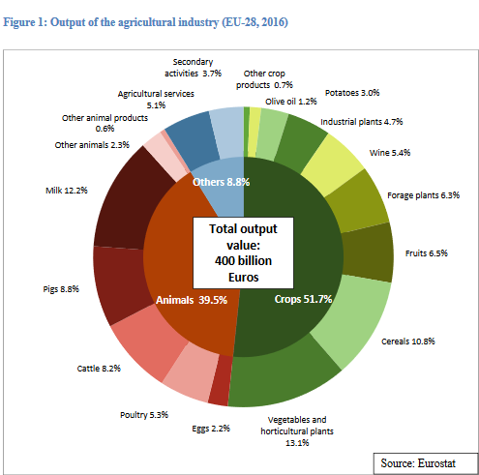
Notes:
3. PRODUCTION:
Agricultural output and input
Output composition
•In 2016, the agricultural industry of the EU-28 produced a total output value of 400billion Euros.
•Slightly more than half of this output value came from crop production (led by vegetables and horticultural plants).
•Another 39.5% came from animals and animal products.
•Agricultural services and secondary activities contributed 8.8% of total output value.

Slide 9
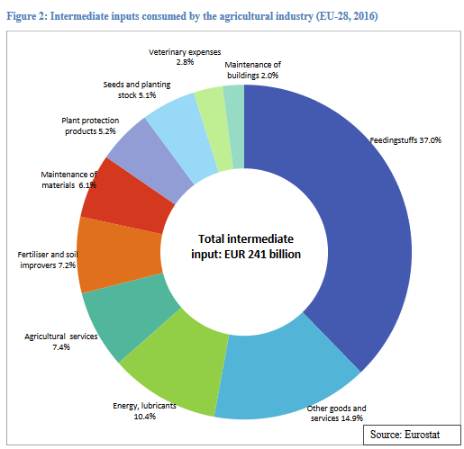
Notes:
Input composition
•Feedingstuffs for animals accounted for the highest share (37%) of total intermediate inputs, more than three times the share of energy and lubricants (10.4%).
•Fertiliser and soil improvers, plant protection products and seeds/planting stocks are inputs used exclusively for crop production. Together, they accounted for 17.5% of total intermediate inputs, less than half the value of feedingstuffs

Slide 10
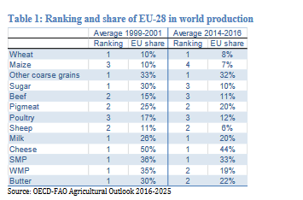
Notes:
The EU remains one of the largest producers of agricultural commodities worldwide, even though it has lost ground with respect to large emerging economies like Brazil. While for wheat and other coarse grains the EU remains the top producer, further consolidating its position over the last 15 years, for maize, where the EU has mostly been a net importer, its ranking deteriorated since 2000 as other countries increased strongly their production (with both the US and China increasing their production by more than 100 million t in 15 years).
For meat, the EU remains a large producer but lost ground with respect to Brazil (which in 15 years increased by more than 7 million t its poultry production (+ 116%), beef +3 million t and pork +1.2 million t).
The EU is still the larger milk producer with more than 160 million t (+13 million t in 15 years, most of which in the last few years) but India is growing fast (+66 million t since 2000) and to a lesser extent China (+30 million t , i.e. more than triple) and the US (+20 million t). In terms of dairy products the EU keeps the top ranking for cheese and SMP, for which it still holds a large share of world production (44% and 33% of world cheese and SMP production respectively). For butter and MP on the other hand the share of world production declined more and the EU lost the first ranking.

Slide 11
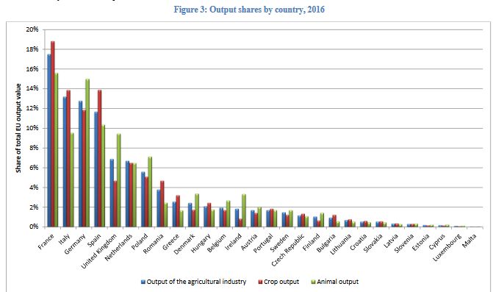
Notes:
Production value by country
•In terms of output value, France was by far the biggest agricultural producer in the EU in 2016 (17.5% of total EU output value), followed by Italy (13.2%), Germany (12.8%) and Spain (11.7%).

Slide 12
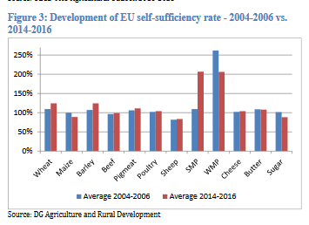
Notes:
The EU is self-sufficient (i.e. production is higher than consumption) for most agricultural commodities with the exception of sheep meat, sugar and maize and to a lesser extent beef. While the self-sufficiency rate is extremely high for export oriented commodities like SMP and WMP, it remains in the range 100% -125% for most of the other commodities (wheat and barley 124%, pigmeat 111%, poultry 104%, butter 108% and cheese 104%). However for almost all commodities for which the EU is self-sufficient one can observe an increase in the degree of self-sufficiency (with the exception of WMP, where anyhow production is the double of consumption).

Slide 13
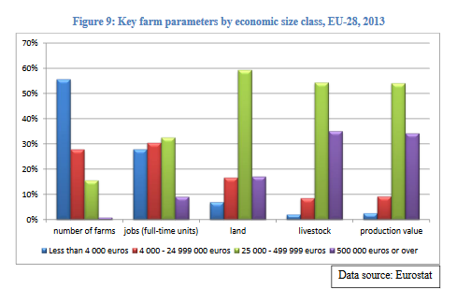
Notes:
4. FARM STRUCTURE
In terms of farm numbers , the smallest farms in economic terms (blue bar) are clearly dominant. They make up more than half of all farms in the EU. Very few farms are in the biggest economic size class (purple bar, hardly visible ).
•Most of the agricultural employment comes from farms in intermediate economic size classes (red and green bars).
•The largest share of land is managed by farms in the upper-mediumeconomic size class (green bar).
•These farms also hold most of the total livestock in the EU –but note the big share of livestock held by farms in the highest economic size class –an indication that many of the mare big livestock producers which generate a lot of output value without necessarily having much land.
•Finally, farms in the upper-medium economic sizeclass generate most of the total production value of EU agriculture.

Slide 14
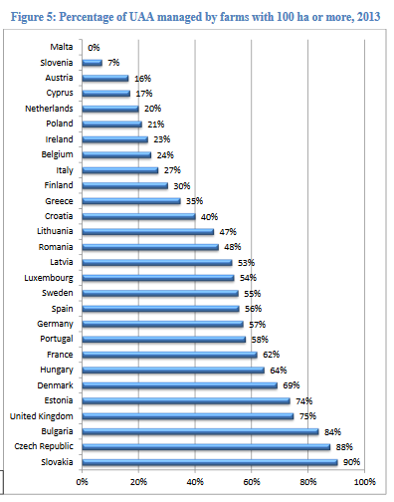
Notes:
Farm structure: Farms with more than 100ha UAA can cover a very large part of the UAA, leaving only very little land for smaller holdings, this situation is specifically problematic in… , where very big farms operate on close to all the land, while many very small farms, share the rest

Slide 15
PART II: ZOOM: Agriculture and ENVIRONMENT (Nature)

Slide 16
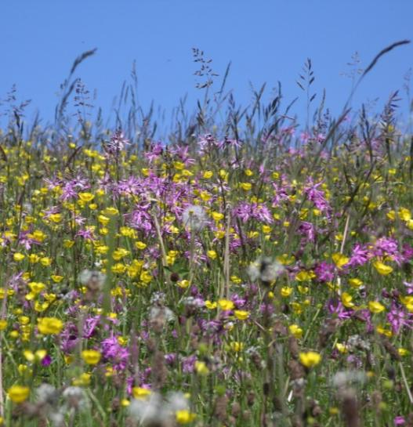
Agriculture and biodiversity
Agriculture...
has a key role in producing public goods (landscapes, farmland biodiversity, climate stability, resilience to flooding, drought and fire)
allowed many species to flourish in Europe in the last millennia
can put huge pressure on environment (soil depletion, water shortages and pollution, loss of biodiversity and landscape features)
Beate Lezius
Notes:
'Greening' the CAP is intended to slow down the decline in farmland biodiversity, its positive effects depend on implementation of specific measures by MS and farmers
Long-term food security can be established by shifting towards more ecological and resource-efficient approaches
Selecting an optimal yield target rather than maximal may outweigh any short-term productivity loss
Preservation of plant varieties and rearing of endangered breeds is crucial for the purpose of supporting a biological basis for food security
A transition towards more sustainable agro-ecosystems and increasing the resource efficiency of agriculture requires advanced agronomic skills
Protecting High Nature Value farmland (HNV) is important because of provided ecosystem services and generated public goods and the socio-economic pressures they face to intensify or abandon production
The increased competition for land (renewable energy, biofuel production etc.) is expected to influence European agriculture greatly

Slide 17
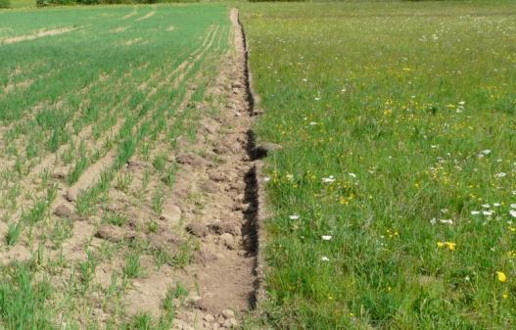
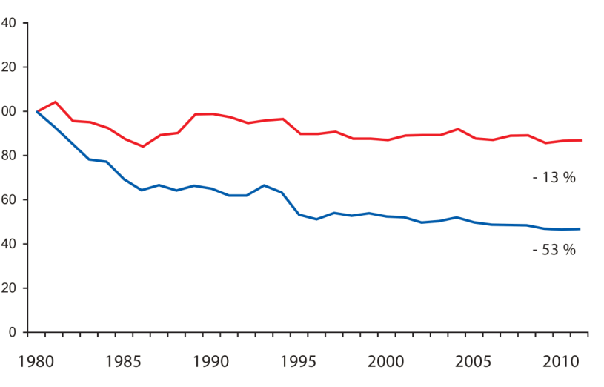
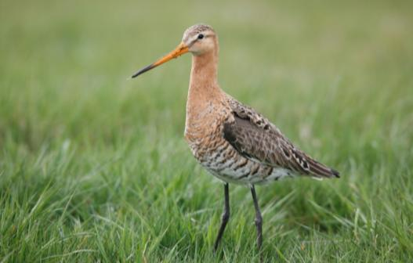
Disaster facts
  EU Nature Report: Status
  64 % of grassland species (non-birds) and
  86 % of grassland habitats unfavourable
  70 % of cropland species (non-birds) unfavourable
  Trends 1980 - 2012
  Grassland habitats: massive deterioration
  Common farmland birds and grassland butterflies: approx. – 50 %
  Black-tailed Godwit: - 37 % (DE - 75 %)
  Turtle Dove – 77 % (UK – 95 %)
  Skylark – 51 %
  Lapwing - 60 % (DE – 75 %)
Gerd Ostermann
Beate Lezius
Common Wild Birds
Farmland Birds
Pan-European Common Bird Monitoring scheme (RSPB/EBCC/BirdLife/Statistics Netherlands)
Skylark 2008-2012; Pan-European Common Bird Monitoring scheme (RSPB/EBCC/BirdLife/Statistics Netherlands)
Frank Derer

Slide 18
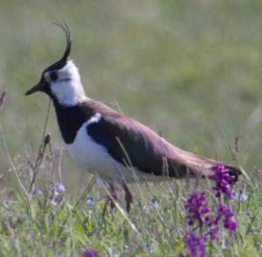
1990
(c) NABU/C. Hektor
(c) NABU/C. Hektor
(c) NABU/C. Hektor
(c) NABU/C. Hektor
(c) NABU/C. Hektor
(c) NABU/C. Hektor
(c) NABU/C. Hektor
(c) NABU/C. Hektor
(c) NABU/C. Hektor
(c) NABU/C. Hektor
(c) NABU/C. Hektor
(c) NABU/C. Hektor
(c) NABU/C. Hektor

Slide 19
2015
(c) NABU/C. Hektor
(c) NABU/C. Hektor
(c) NABU/C. Hektor
(c) NABU/C. Hektor
Lapwing: - 75 %

Slide 20
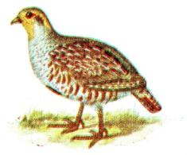
1990
(c) Rapphöna, Iduns kokbok Wikimedia Commons
(c) Rapphöna, Iduns kokbok Wikimedia Commons
(c) Rapphöna, Iduns kokbok Wikimedia Commons
(c) Rapphöna, Iduns kokbok Wikimedia Commons
(c) Rapphöna, Iduns kokbok Wikimedia Commons
(c) Rapphöna, Iduns kokbok Wikimedia Commons
(c) NABU/C. Hektor
(c) Rapphöna, Iduns kokbok Wikimedia Commons
(c) Rapphöna, Iduns kokbok Wikimedia Commons
(c) Rapphöna, Iduns kokbok Wikimedia Commons
(c) Rapphöna, Iduns kokbok Wikimedia Commons
(c) Rapphöna, Iduns kokbok Wikimedia Commons
(c) Rapphöna, Iduns kokbok Wikimedia Commons
(c) Rapphöna, Iduns kokbok Wikimedia Commons
(c) Rapphöna, Iduns kokbok Wikimedia Commons
(c) Rapphöna, Iduns kokbok Wikimedia Commons
(c) Rapphöna, Iduns kokbok Wikimedia Commons
(c) Rapphöna, Iduns kokbok Wikimedia Commons
(c) Rapphöna, Iduns kokbok Wikimedia Commons

Slide 21
2015
(c) NABU/C. Hektor
(c) Rapphöna, Iduns kokbok Wikimedia Commons
Partridge: - 94 %

Slide 22
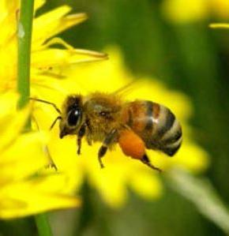
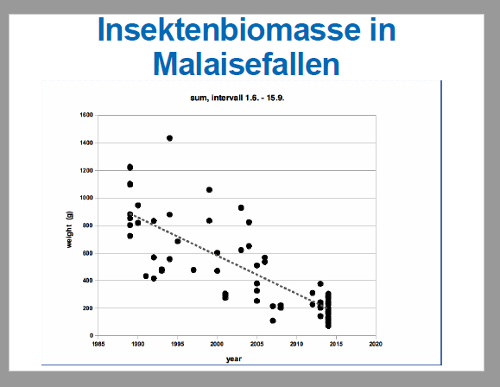
The insect crisis
  EU Red List of Bees
    9.1 % of species threatened with extinction
    (30 % of these endemic to Europe)
    Trends for 80 % of species unknown
  Local studies Western Germany
    Locally now around 60 % of
    bumblebees and butterfly species extinct
    Biomass of flying insects
    declined by 70-80 % in 25 years
  A major ecological disaster seems to be underway,
  and agriculture is in the middle of it!
Frank Derer
Thorsten Krüger
BirdLife Europe

Slide 23
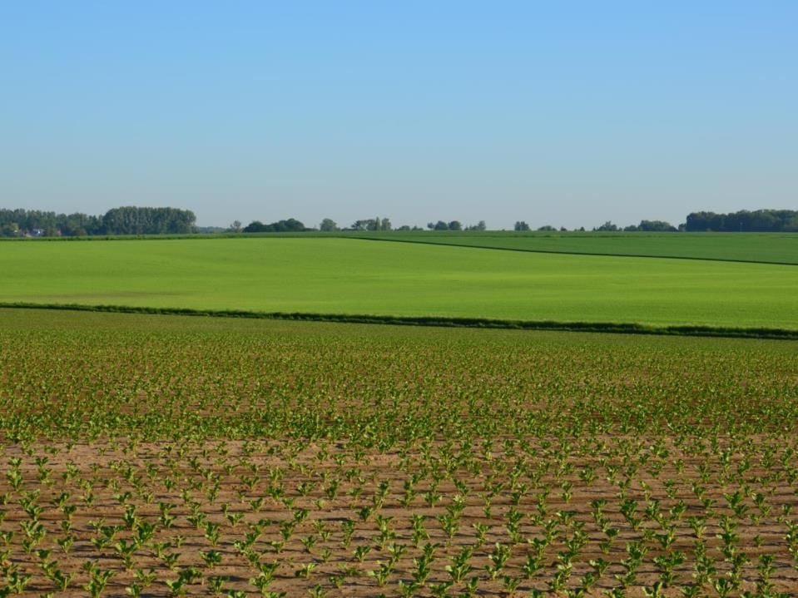
We know the causes of the crisis
Removal of diversification elements
Conversion of semi-natural habitats
More and more winter cereals
Increase of insecticides/herbicides
Ploughing permanent pastures
Mechanisation
Less nesting habitat
Nest destruction
Increased vulnerability to predators
Less feed available
Notes:
The EU’s 2015 State of Nature Report tells us that the number one reason for the decline of biodiversity in the EU is agriculture.
Put simply, it is either intensification or abandonment of sustainable farming systems that leads to a lack of food and habitat for many birds.

Slide 24
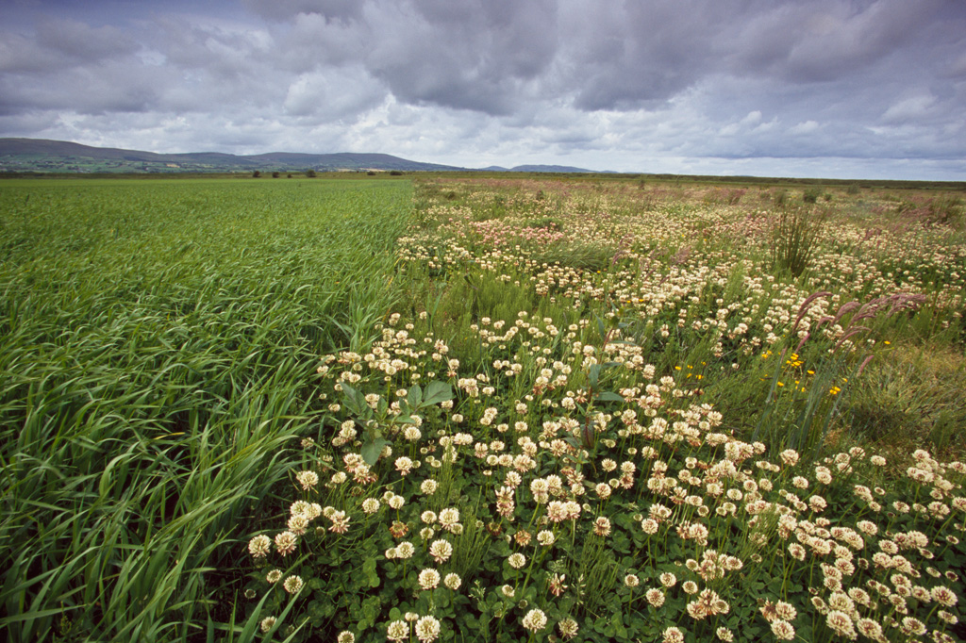
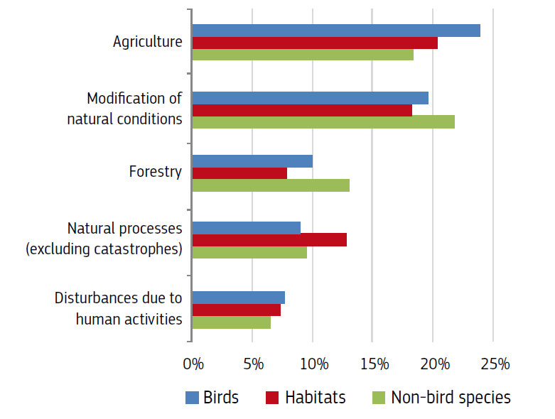
EU State of Nature Report 2015 based on Member State info
Reasons for biodiversity loss
European Commission (2015): The State of Nature in the EU, p.32
Notes:
The State of Nature Report tells us what governments have identified as biggest threats to biodiversity.
The number one reason for the decline of biodiversity in the EU is agriculture. Put simply, it is either intensification or abandonment of sustainable farming systems that leads to a lack of food and habitat for many birds.
The second biggest threat is related to habitat changes due to modifications of the water regime or to a decreased connectivity among habitats, followed by forestry.

Slide 25
PART III: The cap of today

Slide 26
The current structure: 2 pillars, 4 regulations, 2 funds
European Agricultural Guarantee Fund (EAGF) – also includes promotion and school fruit scheme, etc.
European Agricultural Fund for Rural Development (EAFRD)
Pillar 1:
Annual direct payments to “active” farmers (mandatory greening, young farmers, etc.(Direct Payment Regulation (EU) No 1307/2013 )
Market measures Regulation (EU) No 1308/2013
Pillar 2:
Multi-annual rural development schemes programmed by Member States/regions based on 6 priorities Regulation (EU) No 1305/2013
Financing and monitoring (horizontal Regulation (EU) No 1306/2013): rules for CAP expenditure, farm advisory system, control systems and cross-compliance
Notes:
direct payments linked to environmental-friendly practices (Regulation (EU) No 1307/2013) a set of common rules for Direct payments for active farmers including a mandatory "greening" component and a focus on young farmers; all payments are subject to cross-compliance. European Union (EU) countries can grant payments to farmers in areas with natural constraints on a voluntary basis or opt for a simplified scheme for small farms. More on direct support
market measures (Regulation (EU) No 1308/2013): basic elements for a common organisation of markets in agricultural products, such as private storage aid for certain products listed in the regulation, etc.
rural development (Regulation (EU) No 1305/2013): fosters the development of rural areas in terms of competitiveness, sustainable management of natural resources and job creation. It outlines priorities such as the transfer of knowledge and innovation, the promotion of food chain organisations in sectors such as fruits and vegetables, energy or water efficiency in agriculture and food processing, etc. EU countries can align rural development programmes to best respond to country-specific needs
horizontal issues (Regulation (EU) No 1306/2013: lays down the rules for CAP expenditure, the farm advisory system, control systems set up by EU countries and the cross-compliance system

Slide 27
Pillar 1: measures
basic payment (#/ha)
a ‘green’ direct payment for agricultural practices beneficial for the climate and the environment,
a payment to young farmers,
(where applied) a redistributive payment to provide improved support to small and middle-size farms,
(where applied) payments for areas with natural constraints,
(where applied) a small farmers scheme,
and (where applied) voluntary Support coupled to production
Notes:
Direct payments are granted to farmers in the form of a basic income support based on the number of hectares farmed. This so-called ‘basic
payment’ is complemented by a series of other support schemes targeting specific objectives or types of farmers:
https://ec.europa.eu/agriculture/sites/agriculture/files/direct-support/direct-payments/docs/direct-payments-schemes_en.pdf

Slide 28
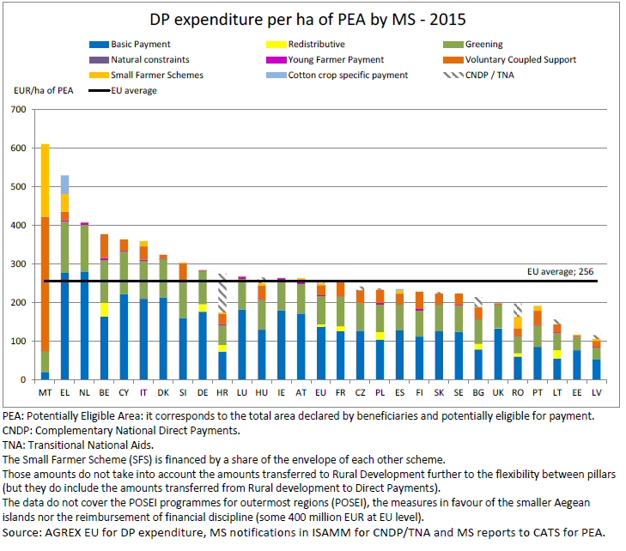
Notes:
http://capreform.eu/how-member-states-are-implementing-the-new-cap/

Slide 29
Pillar 2: measures
118 Rural Development Programmes
Over 20 different measures
    Investments, Risk management, Farm and business development
    Agri/Forest-environment-climate, organic farming, animal welfare, Natura 2000 and Water Framework Directive
    Areas of Natural Constraints
    Leader, Cooperation
    Basic services and village renewal
    Knowledge transfer, Advisory services
    Technical assistance
    Producer Groups, quality schemes

Slide 30
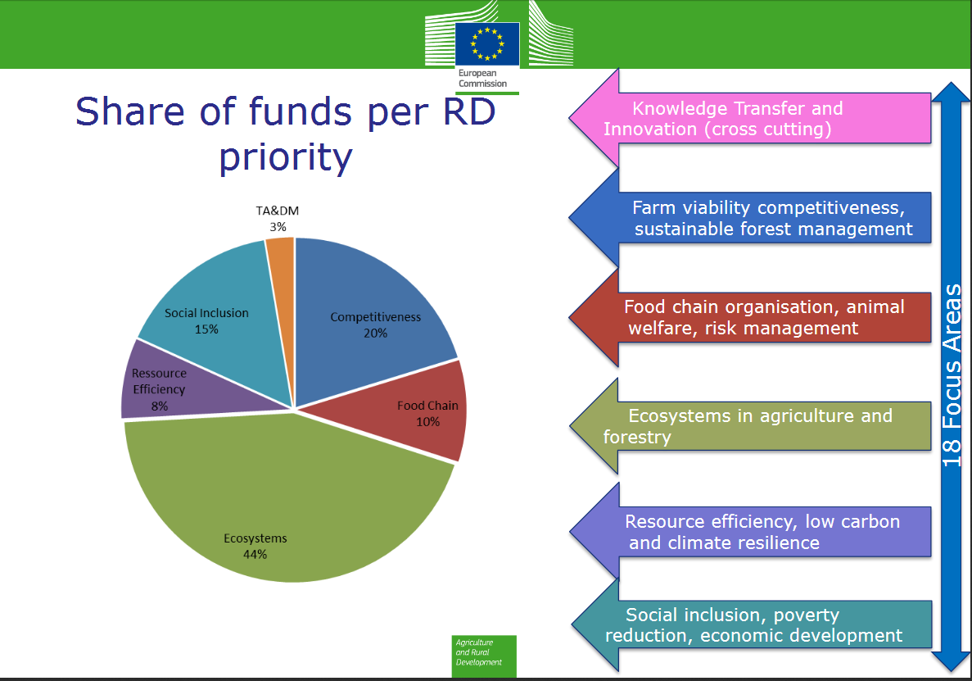
Notes:
https://ec.europa.eu/agriculture/sites/agriculture/files/rural-development-2014-2020/country-files/common/rdp-list_en.pdf

Slide 31
The figures: 2014-2020 programming period
  The CAP 2014-2020 accounts for 38 % of the EU budget.
  Under the 2014-2020 Multiannual Financial Framework, a total of 408.31 billion Euro is earmarked for the CAP.
  This falls under Heading 2: Preservation and management of natural resources - apart from the CAP, it also includes the common fisheries policy, and environmental measures.
  The largest part (Euro 308.72 billion) is allocated to the first pillar (of which 293 billion for direct payments), whereas the remaining Euro 99.6 billion is allocated to the second pillar (which is topped up to Euro 161 billion with other public money).

Slide 32
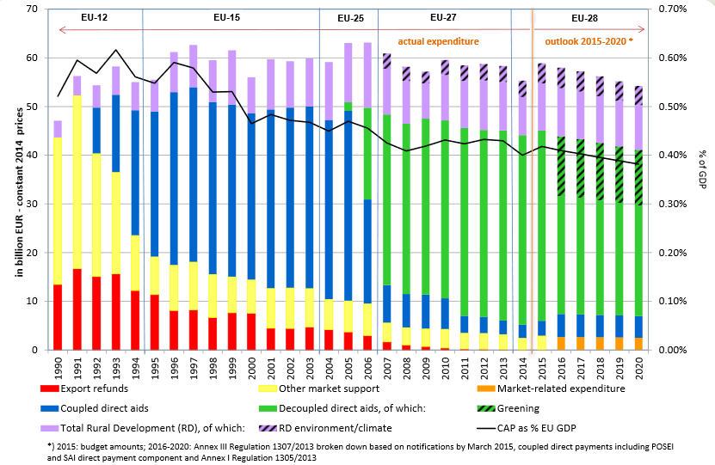
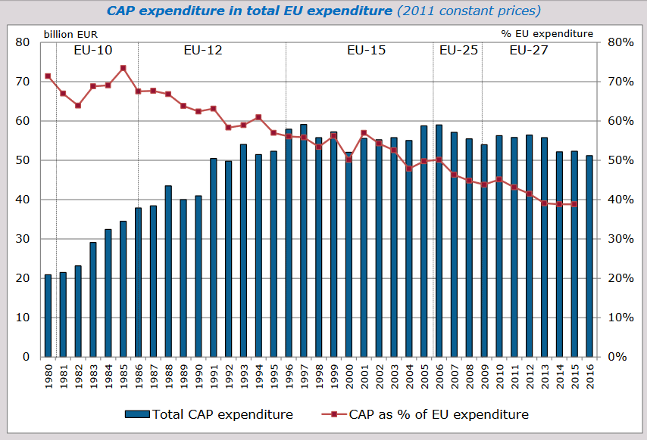
It was once quite a different story …
Notes:
Graph 1: https://ec.europa.eu/agriculture/sites/agriculture/files/cap-post-2013/graphs/graph1_en.pdf
Graph 2: https://ec.europa.eu/agriculture/sites/agriculture/files/cap-funding/pdf/cap-spending-09-2015_en.pdf

Slide 33
PART IV: A history of reforms
Notes:
http://ec.europa.eu/agriculture/50-years-of-cap/files/history/history_book_lr_en.pdf

Slide 34
The CAP: its origin
Western European countries coming out of the war
Six countries create the EEC (forerunner of the EU) in 1957
      agriculture included as part of the common market
      Handing over real power to the community level
CAP objectives enshrined in the Treaty of Rome (art 39)
To increase agricultural productivity by promoting technical progress and by ensuring the rational development of agricultural Production and the optimum utilization of the factors of production, in particular labor;
thus to ensure a fair standard of living for the agricultural community in particular by increasing the individual earnings of persons engaged in agriculture;
to stabilize markets;
to ensure the availability of supplies;
to ensure that supplies reach consumers at reasonable prices.

Slide 35
The CAP: its creation (1962)
Principles
a. Free intra-community trade;
b. Community preference;
c. common financing
The start of:
common market organisations for 6 agri
products,
competition rules,
a schedule to assist intra-community trade
for dairy products, beef and veal was introduced,
establishment of the European Agricultural
Guidance and Guarantee Fund

Slide 36
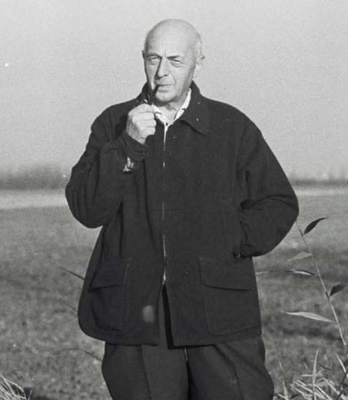
Mansholt: policy entrepreneur and farmer
“Only” 3 new directives in 1972
concerned the modernisation of agricultural holdings,
the abandonment of farming
the training of farmers

Slide 37
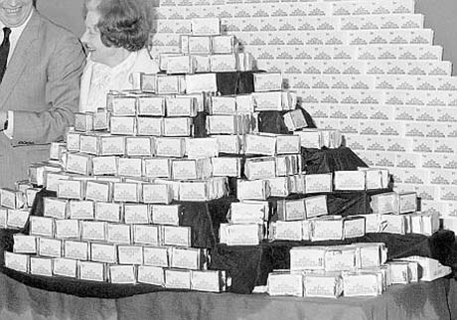
The 80-ies: food mountains
-move towards self sufficiency
-permanent surpluses
-exported, with the help of subsidies, (expensive, market distortions,
-stored
-disposed within the EU.
-1984: milk quotas (sugar quotas already existed)
-1988: max ceiling CAP budget + limit
quantities guaranteed for support

Slide 38
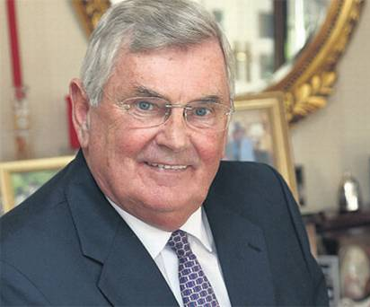
The 1992 Reform - MacSharry
WTO – Uruguay round as one of the key drivers
shift from product support (through prices) to producer support (through income support, direct payments)
Creation of set aside
Limit stocking levels
Encourage retirment and
afforestation

Slide 39
Agenda 2000
-established economic, social, and environmental goals within the objectives of the CAP
-small further reduction in market distortions
-start of the rural development policy
>> Already under the leadership of Franz Fischler

Slide 40
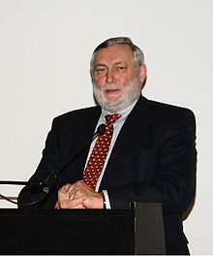
The 2003 Reform – Fischler Reform
Another policy entrepreneur – using the Iraq war to get one of the most radical reforms of the CAP:
-decoupling: consolidated shift to income support by the introduction of a single payment scheme
-introduction of the 'cross compliance' concept
-modulation between pillars

Slide 41
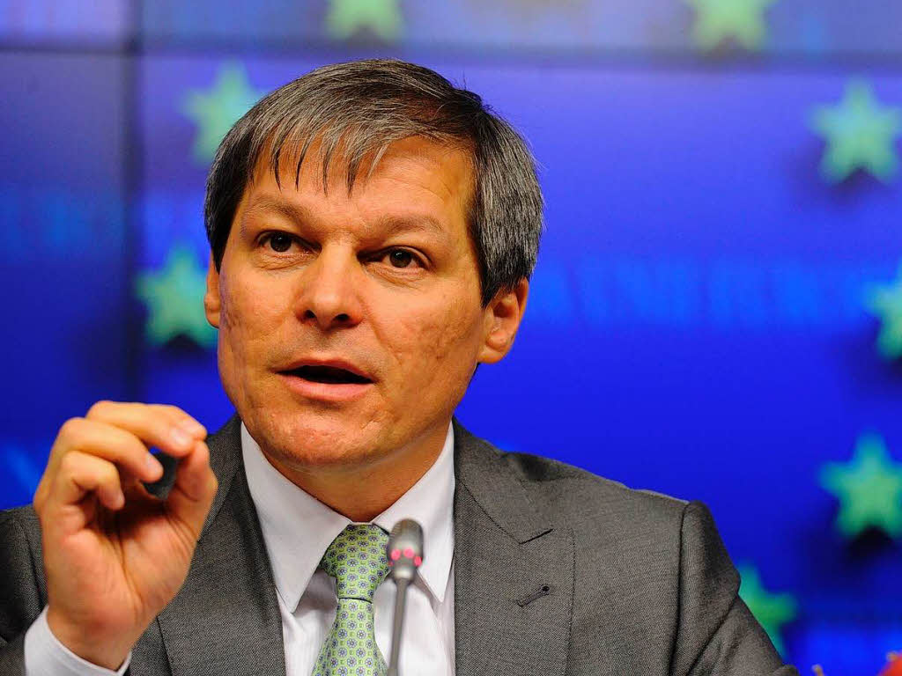
The 2013 Reform: The Ciolos reform
public money for public goods
introduction of greening
producer support
small farmers

Slide 42
Part v: the last reform in more detail

Slide 43
The premise of last CAP reform
The debate for 2014-2020
Real pressure on the EU budget – Budget and Agri debate at same time
Public money for public goods
Context: EU Biodiversity Strategy
  Target 3:
  “Maximise areas under agriculture across grasslands, arable land and permanent crops that are covered by biodiversity-related measures under the CAP”
  first time Co-Decision with 28 Member States
  Food security as a major driver of the public debate

Slide 44
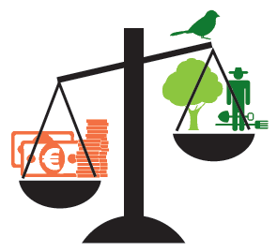
The CAP reality
The money - progressive part of CAP goes down
Rural development budget has been slashed by 13.4 %
compared to previous period
5 countries (HR, MT, PL, SK, HU) will transfer around 3 billion Euro
from second to first pillar

Slide 45
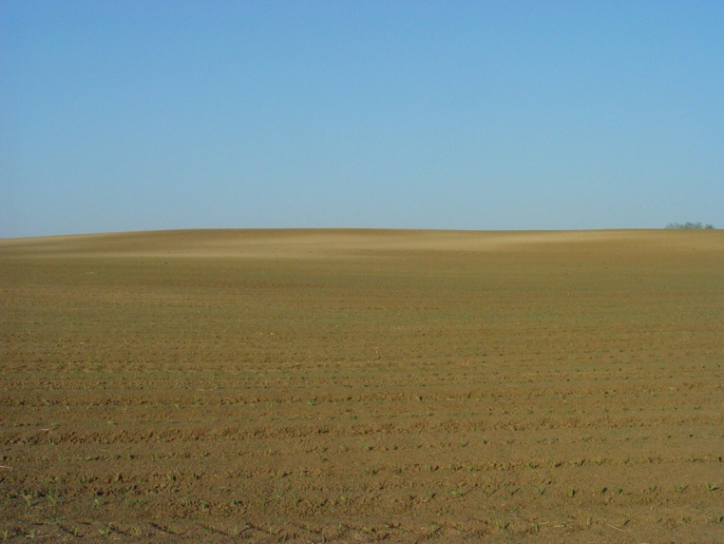
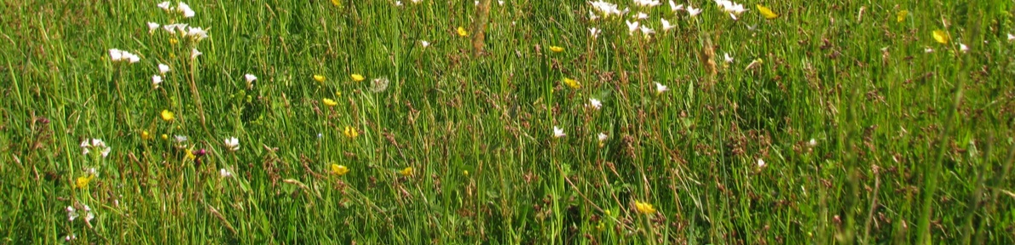
CAP Greening
Lifting the baseline with greening?
Ecological Focus Area - an empty shell?
N fixing crops vs landscape elements
Use of pesticides is allowed
Permanent grassland – avoid destruction?
Only 8 MS designated all grasslands
6 MS designated < 1/2 grasslands
Crop diversification – stop monoculture?
1/4 of arable land exempted
Monoculture deemed green (FR)
Nagy

Slide 46

Rural Development
Good intentions & numbers
MS were asked to maintain the 2007-2013 level of efforts +
spend 30% on environment & climate measures
MS were asked to increase targeting in AEM (ECA)
Agri-environment: 16.8 % of total public expenditure
Total agricultural land under contracts supporting
biodiversity and/or landscapes: 19 %

Slide 47
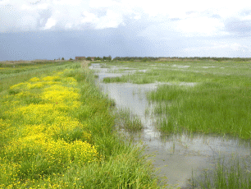
Rural Development
  Too often sad reality
    AEM budgets reduced and targeted biodiversity schemes missing
    or underfunded (e.g. FI, PL, SI, SK, DE, ...)
    Decades of conservation work at risk of being lost
    (e.g. Emilia Romagna - IT)
    Money going to arable farming
    where grassland is the problem (e.g. LV, ES, …)
    Positive exceptions exist (e.g. AU) –
    increased budget for targeted, good AEM

Slide 48
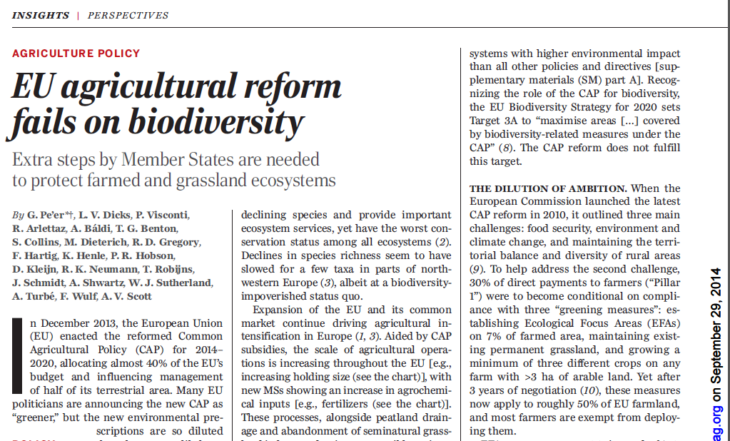
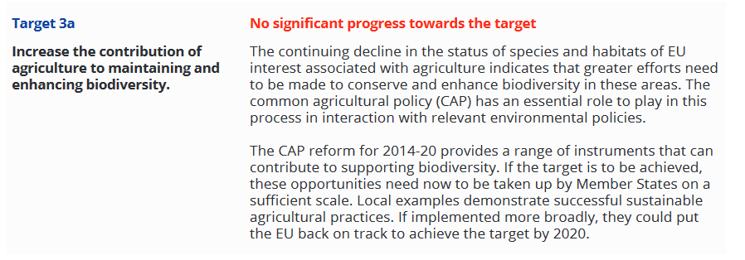

The reality of the premise

Slide 49
‘Green(wash)ing’ Direct Payments
MS choose least ambitious options
Weakening of CC
Reverse modulation
Move from ‘dark green’

Slide 50
pArt vi: where do we go next?

Slide 51
The CAP reform post 2020
Where do we stand
Commission’s impact assessment: February 2017
Commission’s public consultation: May 2017
Commission’s Communication: November 2017
Commission’s Communication on MFF: May 2018
Commission’s legislative proposals on the CAP: June 2018
EP: Group positioning, Report on MFF ongoing
Council: debate started under Maltese Presidency 2017
Stakeholders: positioning ongoing
Brexit: UK scheduled to leave EU: 29 March 2019
Election EP: May 2019 and appointment new Commission

Slide 52


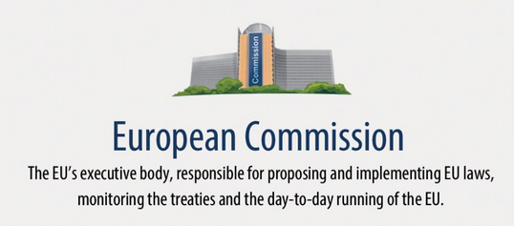
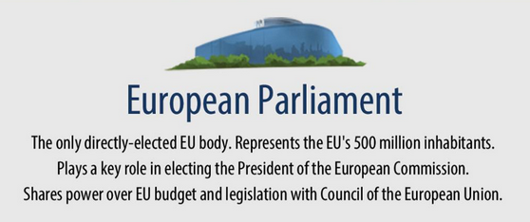

Influencing the EU
Preliminary ruling
Consultation, Complaint, ECI..
Exchange MEPs
Exchange MS
Source: europarl.europa.eu

Slide 53
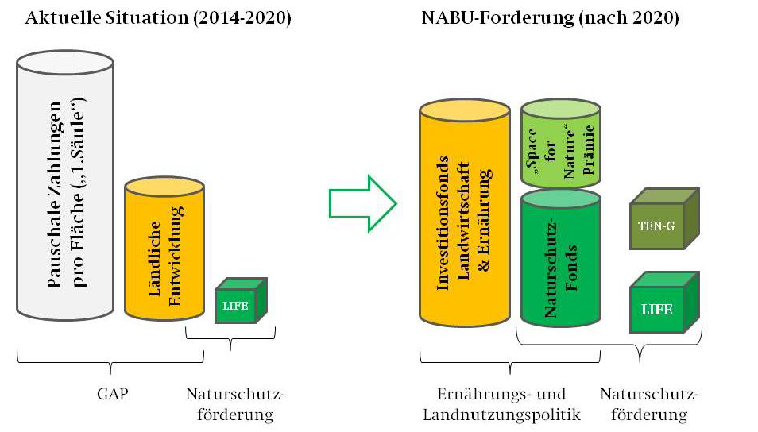
The NGO way forward
The BirdLife (and EEB) proposal
Transition instrument for sustainable farming: temporary, finance switch to high-quality, nature-/animal-friendly and profitable economic model, invest in healthy, economically diverse rural areas.
Sustainable Food instrument: investments to build up sustainable value chains, reduce food waste and increase the demand for healthy and environmentally sound food at fair prices.
Nature and Biodiversity instrument:
the central EU fund for financing about
75 % of the costs of implementation of
the EU nature legislation (Natura 2000).
Space for Nature instrument: an
area-based entry level payment scheme
for strictly non-productive elements.

Slide 54


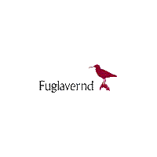
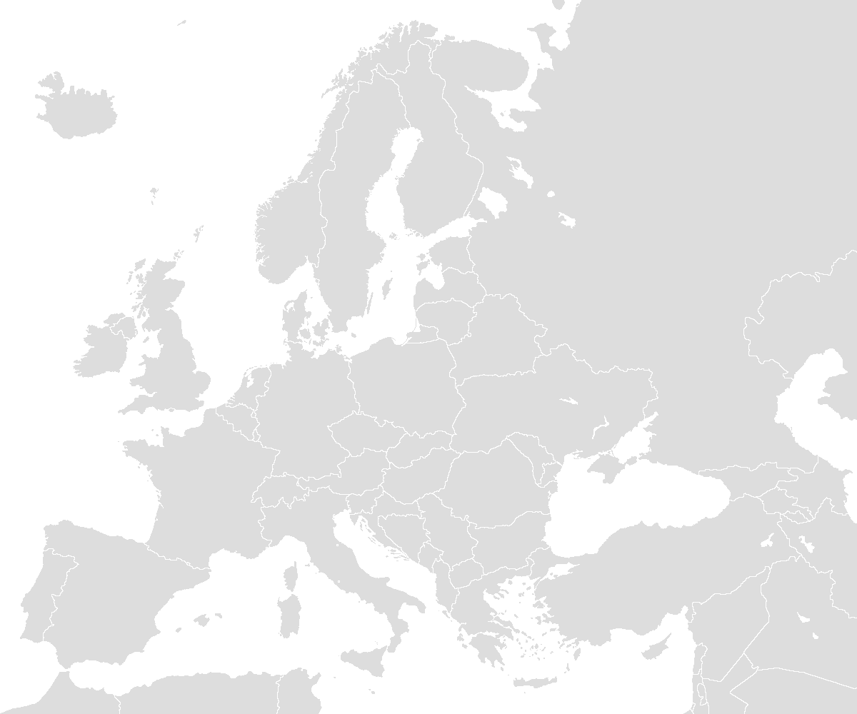
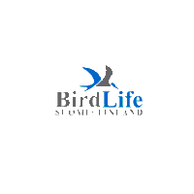
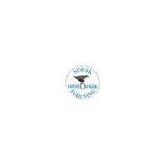
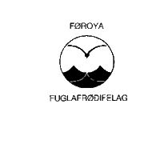

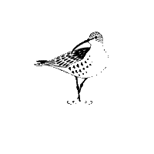








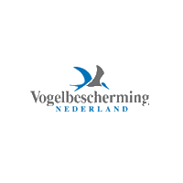



























NGOs in Brussels
  David versus Goliath
  Umbrellas, supported by national partners
  Advocating to EU‘s institutions
  Events, briefings, studies
  Legal assessments
  Good cooperation, i.e. Green 10
  Exchange back to national level
  Transparency

Slide 55









#NatureAlert

Slide 56

#LivingLand: „Wir haben es satt“ Protests (2017)
Foto: NABU

Slide 57


LivingLand: CAP Public Consultation 2017

Slide 58

LivingLand: 260,000 supporters / 600 logos
Foto: EEB/BirdLife Europe

Slide 59

Building the arguments: Environment
Fitness Check of the CAP

Slide 60
Building the arguments: Sio-Economic
Maintaining Direct Payments based on “Grossly misleading”* Commission (2017) graph
* Prof. Alan Matthews
FRANCE (source: micro-sources) | 1997 € | 2003 € | Annual percentage change 1997–2003 (%)
Per household
Average
Farmers’ households | 32,310 | 29,890 | -1.3
All households | 25,570 | 28,410 | 1.8
Farmers as percentage of all households | 126.4 | 105.2
Median
Farmers | 27,750 | 27,940 | 0.1
All households | 24,230 | 24,230 | 1.7
Farmers as percentage of all households | 126.8 | 115.3

Slide 61

Building the arguments: Fairness
80% of direct payments → 20% of beneficiaries
35% of payments → 1.5% beneficiaries
Source: Alan Matthews, 2016
Notes:
Source of graph: http://capreform.eu/focus-on-the-distribution-of-direct-payments/

Slide 62
The post 2020 CAP
‘A Smarter, Modern and Sustainable CAP’?
Key idea:
More flexibility for Member States
Results driven
EU level set objectives
But, inconsistencies:
In denial of environmental problems of farmland
Maintenance of Direct Payments and current structure

Slide 63
Why also this CAP reform will remain an interesting discussion to follow!
Brexit
Sustainable Development Goals and Paris Agreement
European Elections
Larger Public interest
Back to the past market wise?
What do you think is the future for food and farming? The future of Europe? The future of the CAP?

Slide 64
Thank you for your attention!
Trees Robijns
Agriculture and Bioenergy policy officer
NABU
Charitéstraße 3
10117 Berlin
trees.robijns@nabu.de
www.NABU.de

